Slide 1
Hats and boots
Year 3 – Year 4
Teacher presentation
Play a tic-tac-toe-style game focused on sustainable cattle, sheep and goat production.
© Meat & Livestock Australia 2026. MLA Australian Good Meat Education has been developed with specialist education services of the Primary Industries Education Foundation Australia. This educational resource is provided under a Creative Commons Licence CC-BY-SA 4.0.

Slide 2
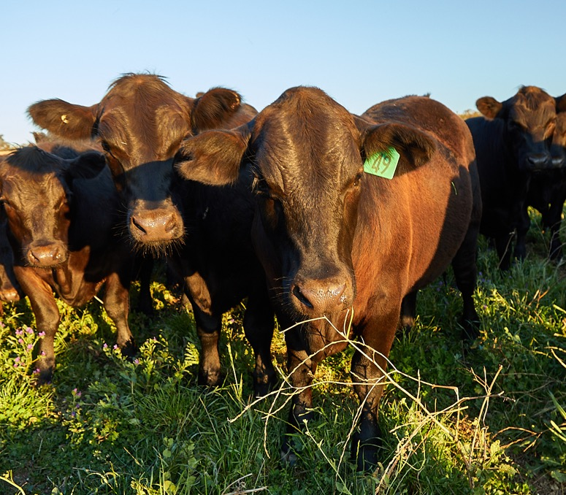
Question
1
Lesson 1
Living things on the farm
Organisms (plants and animals) are living things.
Name one example of an organism found on a farm.

Slide 3
Answer
1
Lesson 1
Living things on the farm
Many possible answers, such as:
Sheep
Goat
Cow
Lucerne plant
Dung beetle
Worm
Bee
Black cockatoo
Tree

Slide 4
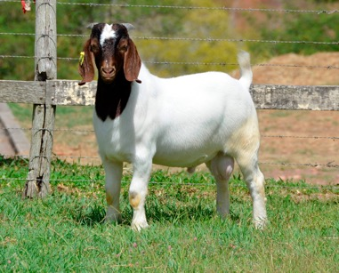
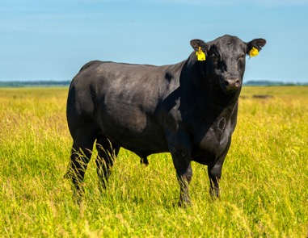
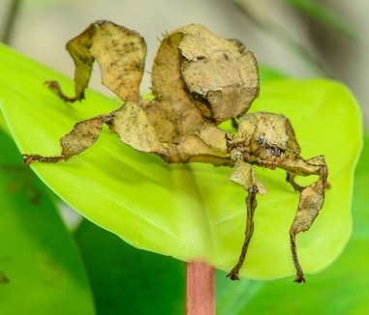
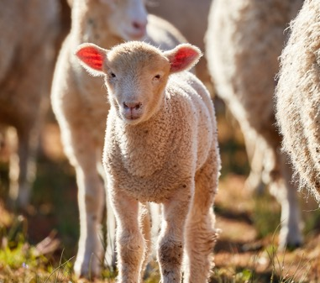
Question
2
Lesson 1
Living things on the farm
A mammal is a warm-blooded (endothermic) animal that breathes air, has hair or fur, and usually gives birth to live young. Mammals also provide their babies with milk.
Which of these images is not a mammal?
a. Boer goat
b. Angus bull
c. Spiny leaf stick insect
d. Lamb

Slide 5
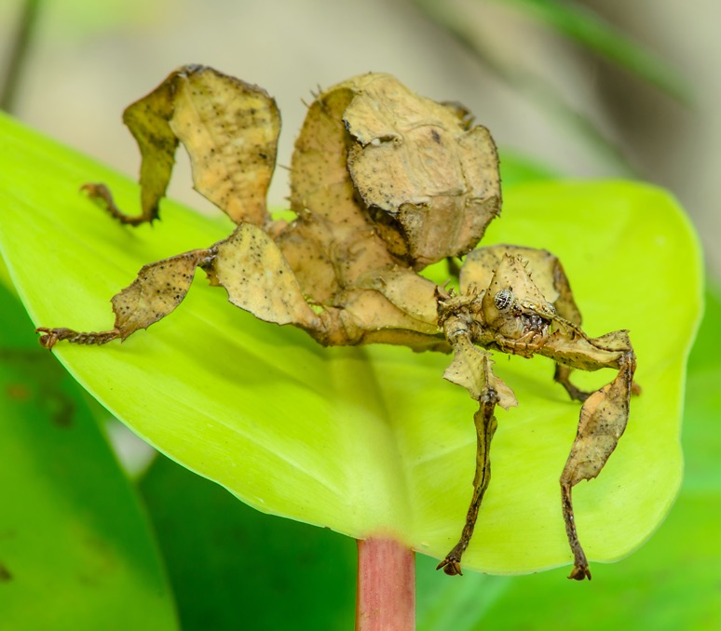
Answer
2
Lesson 1
Living things on the farm
Spiny leaf stick insect

Slide 6
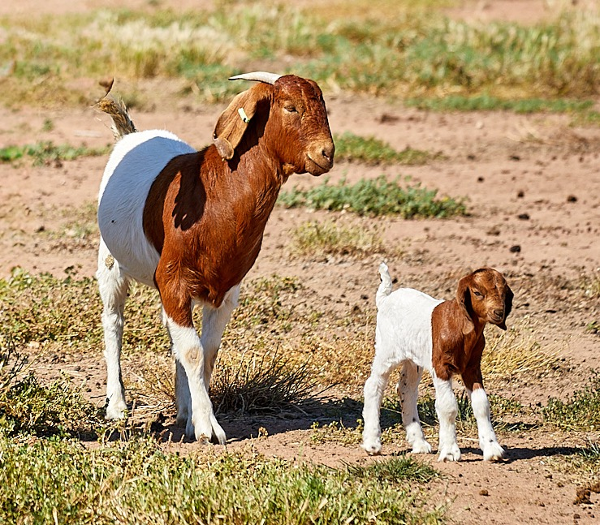
Question
3
Lesson 1
Living things on the farm
Living things can survive in many different environments.
What are three features of living things?

Slide 7
Answer
3
Lesson 1
Living things on the farm
Any three of the following:
Movement
Respiration
Sensitivity
Growth
Reproduction
Excretion
Nutrition

Slide 8
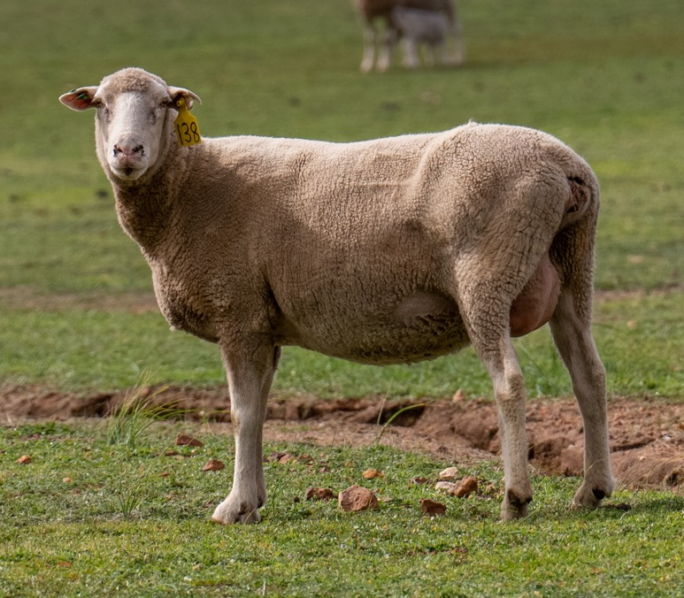
Question
4
Lesson 2
Life cycles on the farm
A ram is an adult, male sheep.
What is the name given to an adult, female sheep?

Slide 9
Answer
4
Lesson 2
Life cycles on the farm
Ewe

Slide 10
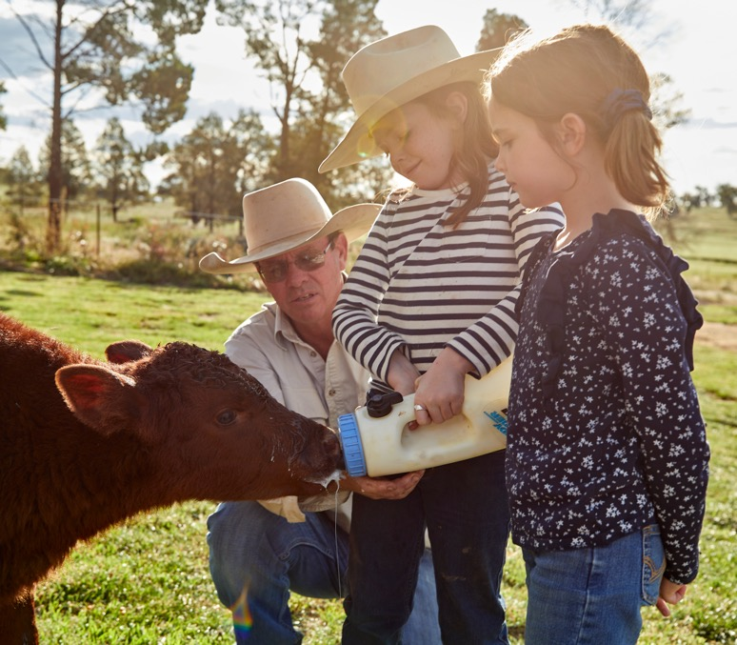
Question
5
Lesson 2
Life cycles on the farm
If a mother cow or sheep is unable to take care of her offspring, farmers do this job to feed and raise a new calf or lamb.
What are baby lambs and calves raised by farmers called?

Slide 11
Answer
5
Lesson 2
Life cycles on the farm
Poddy lambs or poddy calves

Slide 12
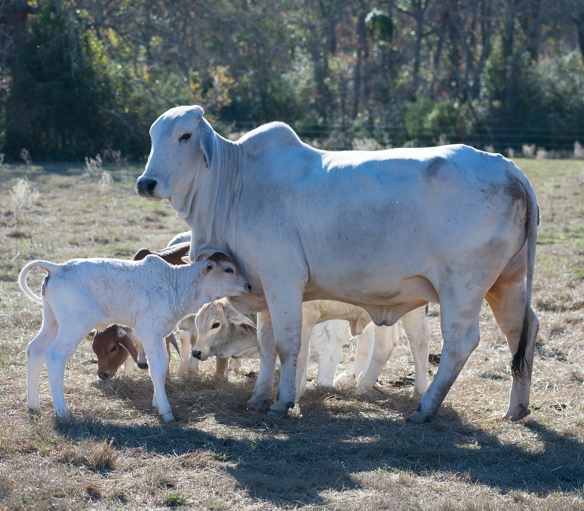
Question
6
Lesson 2
Life cycles on the farm
When female cows are around
1.5–2 years old, they are old enough to have their own offspring.
Approximately how many months is a female cow pregnant before her calf is ready to be born?
2 months
5 months
9 months
18 months

Slide 13
Answer
6
Lesson 2
Life cycles on the farm
9 months

Slide 14
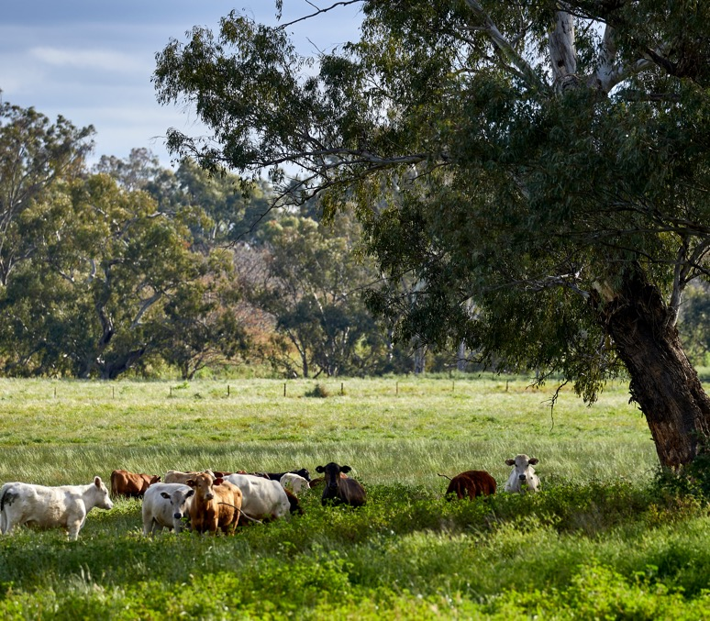
Question
7
Lesson 3
Depending on each other
Trees are very important in a farm ecosystem.
How do sheep, cattle and goats depend on trees?

Slide 15
Answer
7
Lesson 3
Depending on each other
Farm animals depend on trees for shelter and protection.
They need to stay cool in hot weather, so they move to find shade under trees.
They also need to be protected from the wind and cold and will shelter under trees to find warmth.

Slide 16
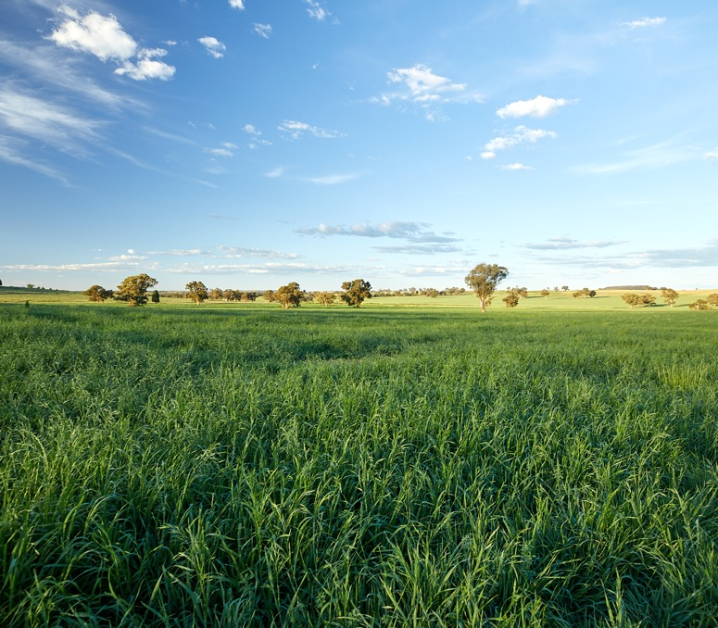
Question
8
Lesson 3
Depending on each other
Plants are producers that use sunlight, carbon dioxide and water to make their own energy.
Name one example of a plant
(a producer) that can be found
on a farm.

Slide 17
Answer
8
Lesson 3
Depending on each other
Many possible answers, such as:
Tree
Grass
Clover
Wheat
Lucerne
Leucaena

Slide 18
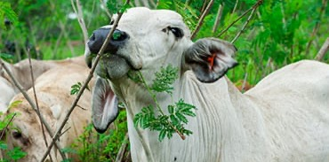
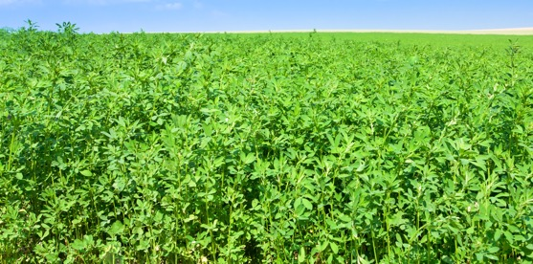
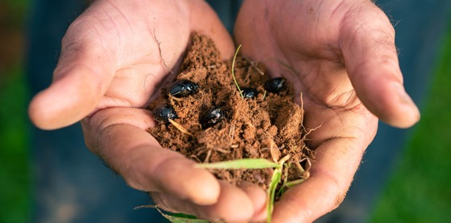
Question
9
Lesson 3
Depending on each other
Plants are producers that grow on farms.
Herbivores are animals that consume plant material.
Decomposers are organisms that break down organic material.
Match each term to the correct picture.
Producer
Herbivore
Decomposer
1
2
3

Slide 19
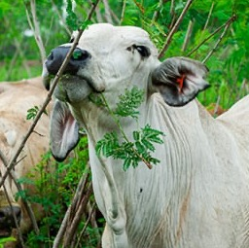
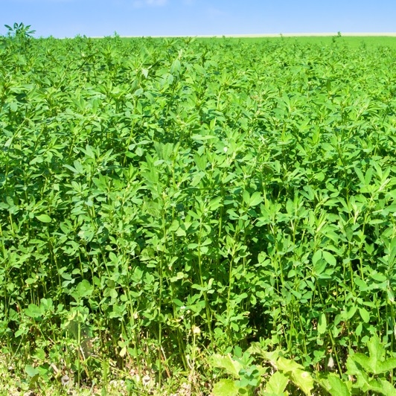
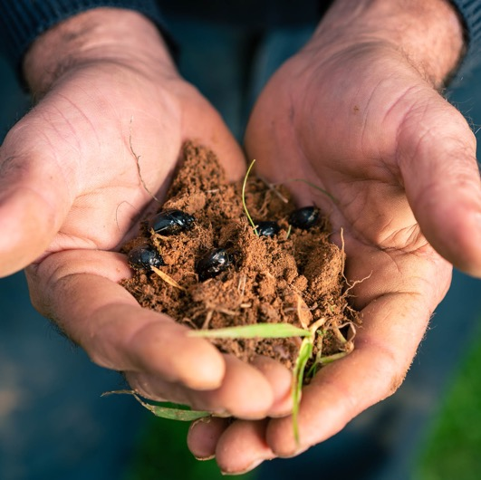
Answer
9
Lesson 3
Depending on each other
1
2
3
Herbivore (cattle)
Producer (lucerne)
Decomposer
(dung beetle)

Slide 20
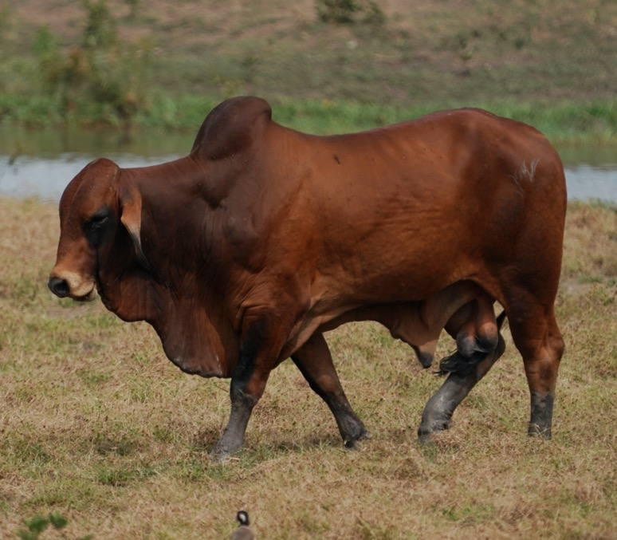
Question
10
Lesson 4
Livestock on the farm
Cattle and sheep are located on farms throughout Australia.
Which state or territory has the most cattle in Australia?
Western Australia
Northern Territory
Tasmania
Queensland

Slide 21
Answer
10
Lesson 4
Livestock on the farm
Queensland

Slide 22
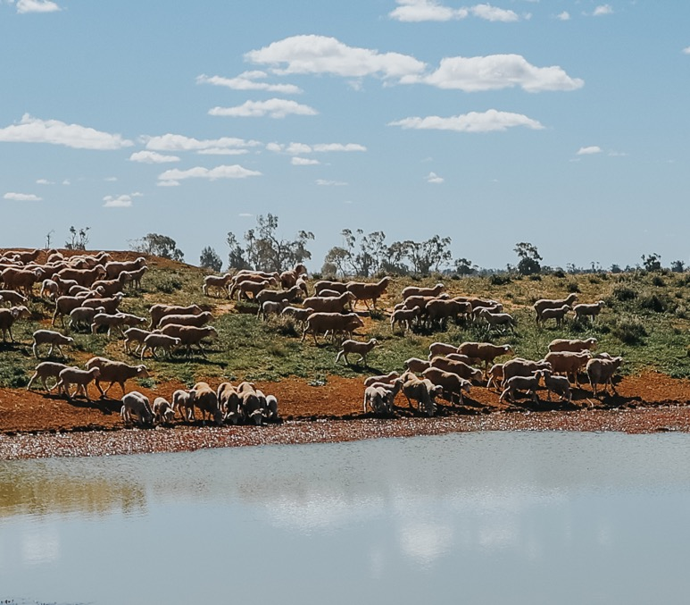
Question
11
Lesson 4
Livestock on the farm
Farmers need to regularly check that their animals have enough water.
How much water can
sheep drink in a day?
1–3 litres
4–6 litres
2–14 litres
8–16 litres

Slide 23
Answer
11
Lesson 4
Livestock on the farm
2–14 litres depending on how hot they are and how much they have eaten.

Slide 24
Question
12
Lesson 4
Livestock on the farm
The plants and animals we use for food and fibre are produced in locations best suited to their needs.
Why is it important for farmers to select breeds of animals and plants that are suited to their location?

Slide 25
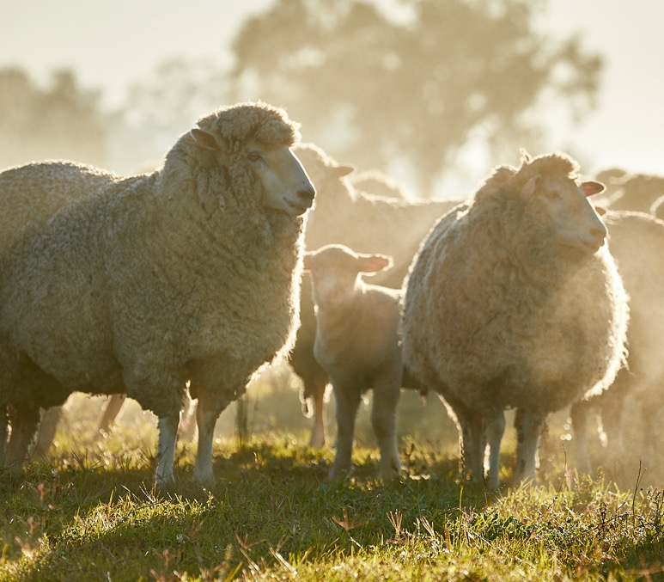
Answer
12
Lesson 4
Livestock on the farm
Any of the following:
They will grow better and produce more food and fibre
They will stay healthy when they live in places that suit them

Slide 26
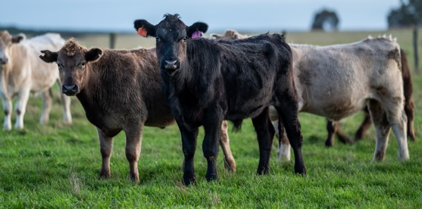
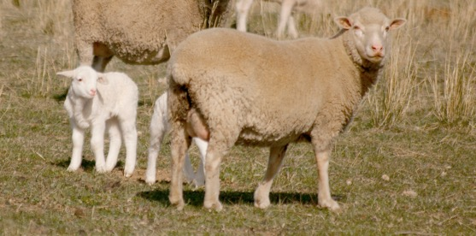
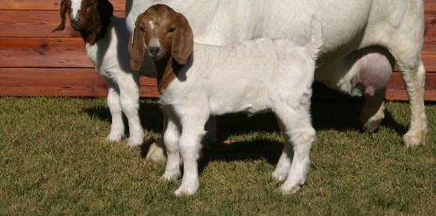
Question
13
Lesson 5
Modelling changes on the farm
Different terms are used to describe stages of life cycles. Terms to describe a human throughout their life cycle include baby, child, teenager, adult and elder.
Match these animals at different stages of their life cycles
to their correct terms.
Kid
Yearling or vealer
Ewe
1
2
3

Slide 27
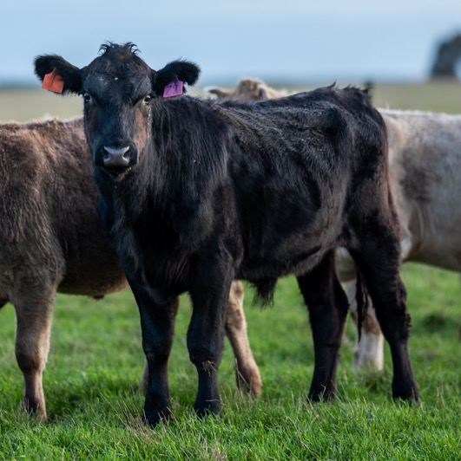
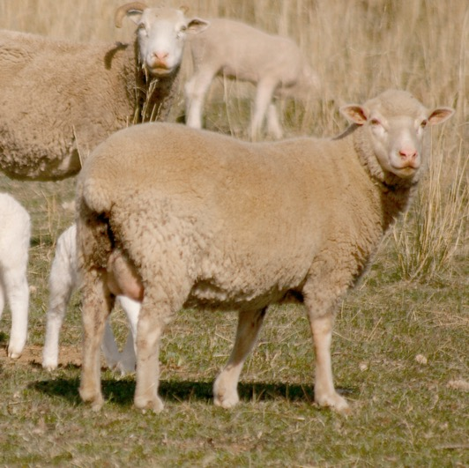
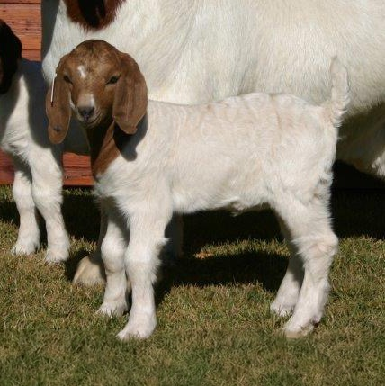
Answer
13
Lesson 5
Modelling changes on the farm
1
2
3
Yearling or vealer
Ewe
Kid

Slide 28
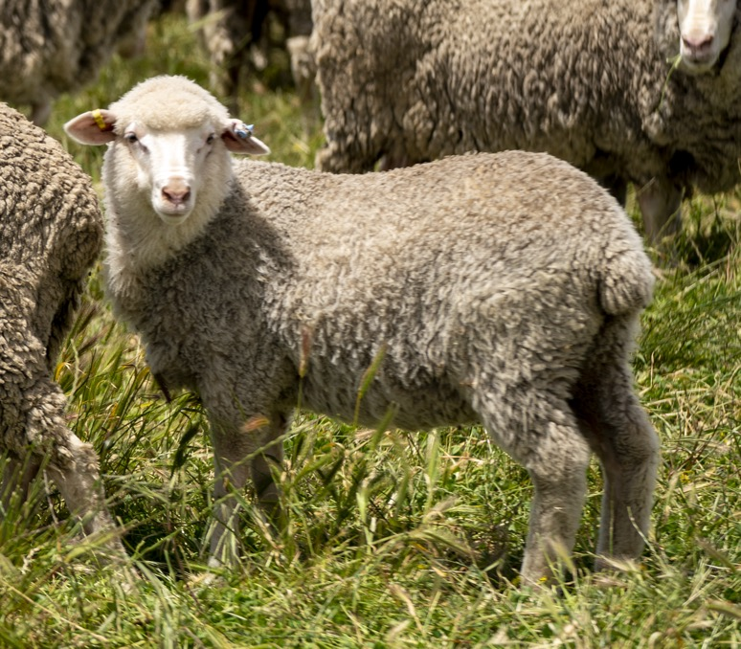
Question
14
Lesson 5
Modelling changes on the farm
A life cycle is a series of changes that a living thing goes through during the time that it is alive.
Which of these is not a stage of the life cycle of a sheep?
Lamb
Buckling
Hogget

Slide 29
Answer
14
Lesson 5
Modelling changes on the farm
Buckling (young male goat)

Slide 30
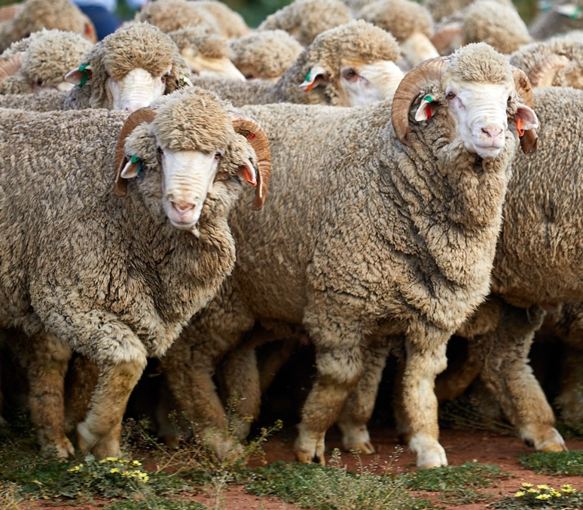
Question
15
Lesson 5
Modelling changes on the farm
As animals grow, their size and appearance change from one life cycle stage to the next.
True or false:
Only male cattle, sheep and goats can grow horns as they get older.

Slide 31
Answer
15
Lesson 5
Modelling changes on the farm
False. Both male and female cattle, sheep and goats can have horns.

Slide 32
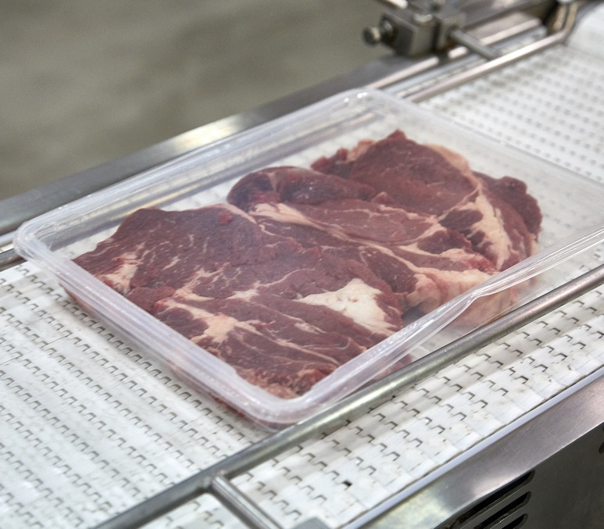
Question
16
Lesson 6
Technology and food from the farm
There are many different types of packaging used for meat products.
Why is food packaging important?

Slide 33
Answer
16
Lesson 6
Technology and food from the farm
Any of the following:
to extend the shelf life of food
to prevent it from spoiling quickly
to keep it safe for eating
to provide nutritional and other information for consumers

Slide 34
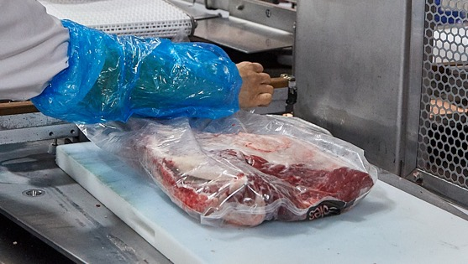
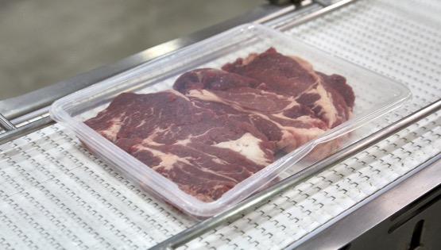
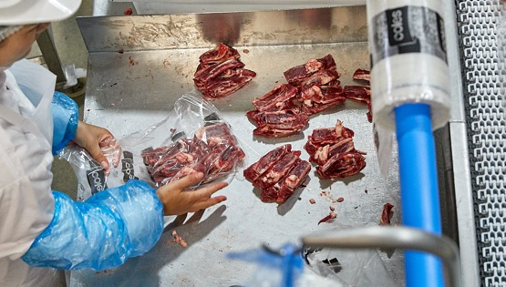
Question
17
Lesson 6
Technology and food from the farm
How long you can store red meat depends on how it is packaged.
Match the types of packaging to each picture.
Overwrapping
Modified atmosphere
Vacuum
1
2
3

Slide 35
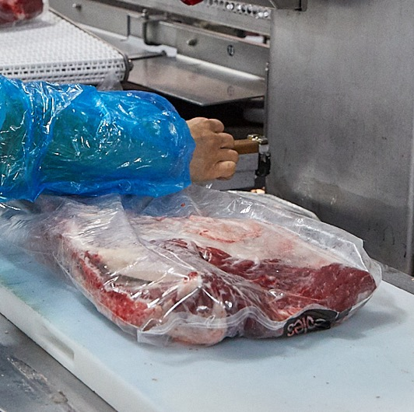
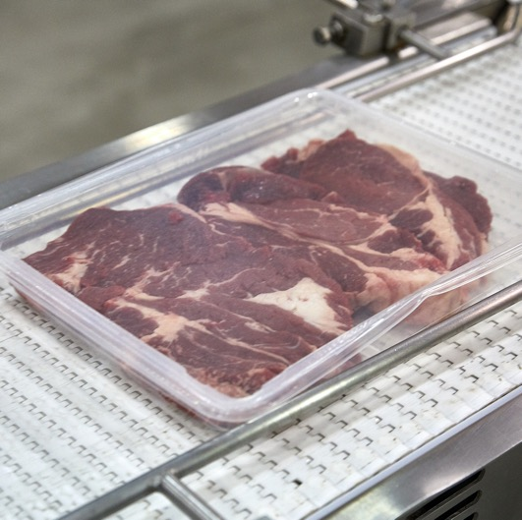
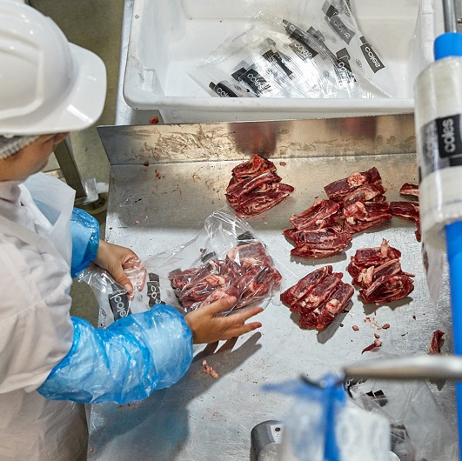
Answer
17
Lesson 6
Technology and food from the farm
1
2
3
Vacuum
Overwrapping
Modified atmosphere

Slide 36
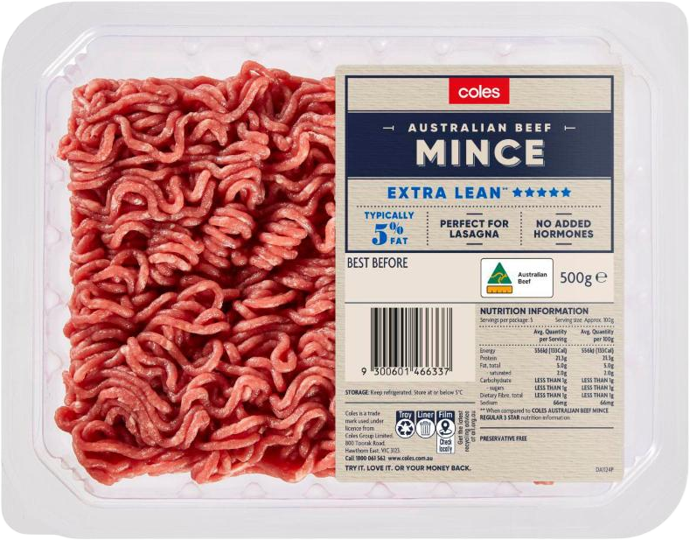
Question
18
Lesson 6
Technology and food from the farm
Labels help customers make safe and informed choices about food products.
What is one piece of information that can be found on the label of a
red meat product?

Slide 37
Answer
18
Lesson 6
Technology and food from the farm
Any of the following:
Date marking
Cut name
Retailer brand
Country of origin
Nutritional information, ingredient list and percentage declaration
Cooking/storage hints
Name and address of the supplier
Declaration of certain substances

Slide 38
Scan the QR code to access a range of Australian
Curriculum-aligned 3–4 learning resources.
Lessons • Student resources • Classroom posters • Paddock to plate card game • Teaching video
© Meat & Livestock Australia 2026. MLA Australian Good Meat Education has been developed with specialist education services of the Primary Industries Education Foundation Australia. This educational resource is provided under a Creative Commons Licence CC-BY-SA 4.0.

