Slide 1
Hats and boots
Year 5 – Year 6
Teacher presentation
Play a tic-tac-toe-style game focused on sustainable cattle, sheep and goat production.
© Meat & Livestock Australia 2026. MLA Australian Good Meat Education has been developed with specialist education services of the Primary Industries Education Foundation Australia. This educational resource is provided under a Creative Commons Licence CC-BY-SA 4.0.

Slide 2
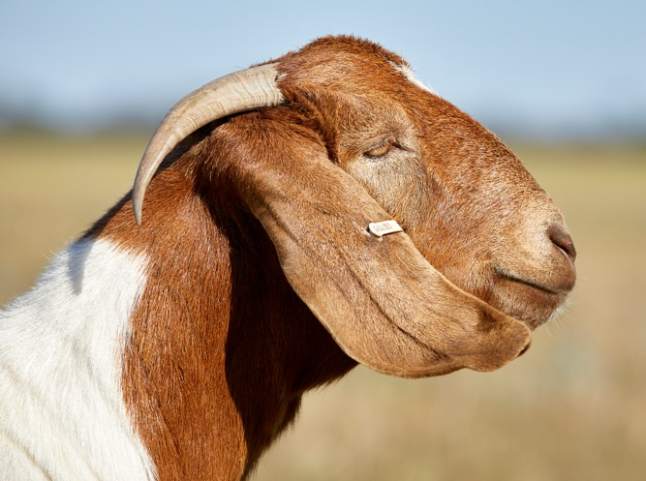
Question
1
Lesson 1
All about adaptations
Animals have special features that help them survive in their environment. These adaptations are inherited characteristics that support survival and reproduction.
Which of the following best describes
an adaptation of a goat?
Large, sharp teeth to defend
themselves against prey
Large ears to lose heat and stay cool
Large eyes to see well in the dark

Slide 3
Answer
1
Lesson 1
All about adaptations
Large ears to lose heat and stay cool

Slide 4
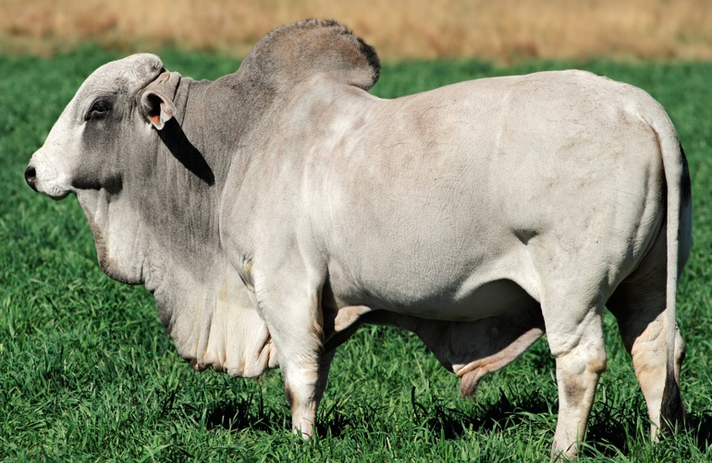
Question
2
Lesson 1
All about adaptations
Different breeds of cattle are suited to different climates across Australia.
Which statement correctly describes Bos indicus cattle?
They have loose skin and tolerate heat and humidity well
They originated in Europe and prefer cooler climates
They are a short-haired breed raised mainly in southern Australia

Slide 5
Answer
2
Lesson 1
All about adaptations
They have loose skin and tolerate heat and humidity well

Slide 6
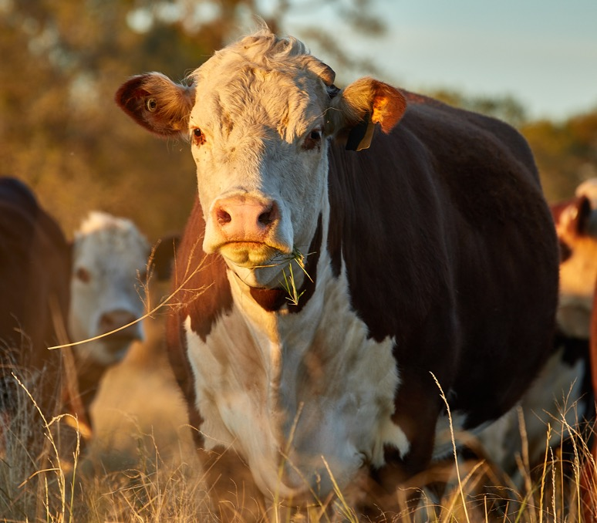
Question
3
Lesson 1
All about adaptations
Producers select animals with traits, or adaptations, that help them survive and reproduce in their environments.
What are three ways that adaptations can be classified?

Slide 7
Answer
3
Lesson 1
All about adaptations
Structural
Behavioural
Physiological

Slide 8
Question
4
Lesson 2
From paddock to plate
Livestock are raised by farmers
who ensure the animals stay
healthy and grow well.
What is another name for the people who breed and raise livestock?
Consumers
Retailers
Producers

Slide 9
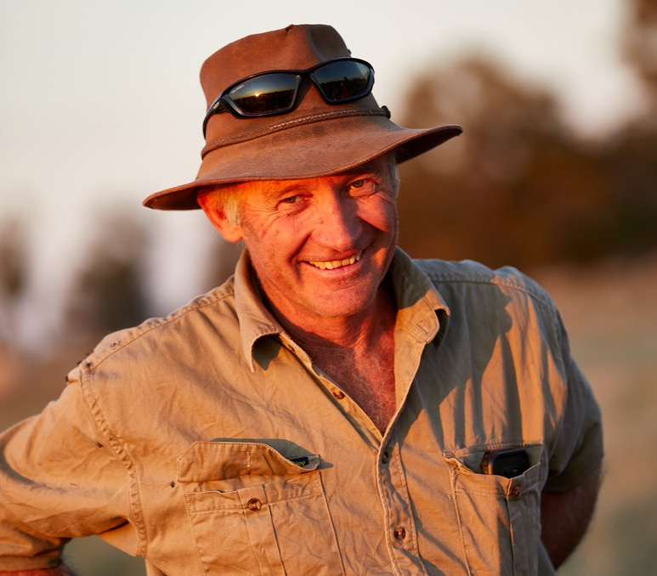
Answer
4
Lesson 2
From paddock to plate
Producers

Slide 10
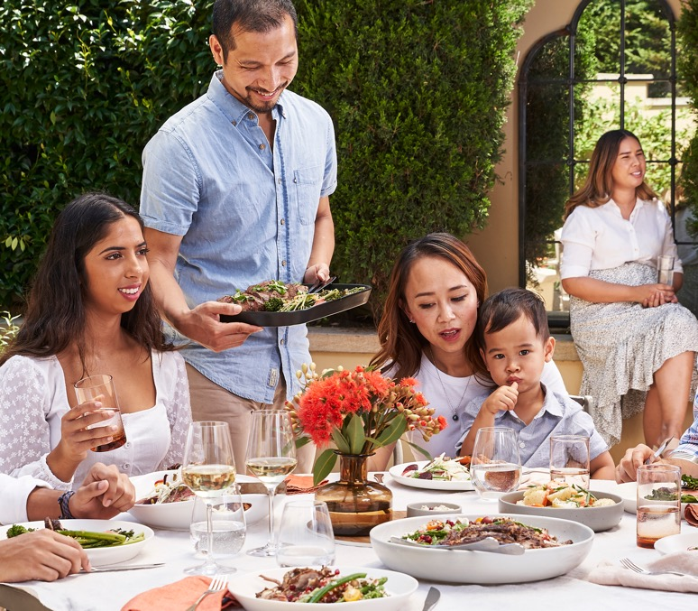
Question
5
Lesson 2
From paddock to plate
It is important that people know where their food comes from and how it is produced.
What does the term
‘paddock to plate’ describe?

Slide 11
Answer
5
Lesson 2
From paddock to plate
The steps a product takes from when it is grown on the farm to when it becomes a finished product ready to eat (on the plate).
This is also called a supply chain.

Slide 12
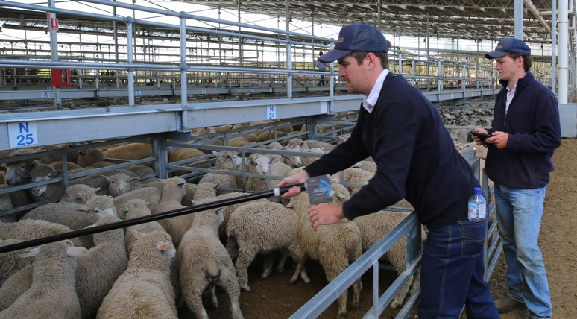
Question
6
Lesson 2
From paddock to plate
The National Livestock Identification System (NLIS) is used in Australia to maintain animal traceability and biosecurity.
What is the main purpose of the NLIS?
To identify the best animals
for breeding
To track the movements of
individual cattle, sheep and goats
To weigh animals before sale

Slide 13
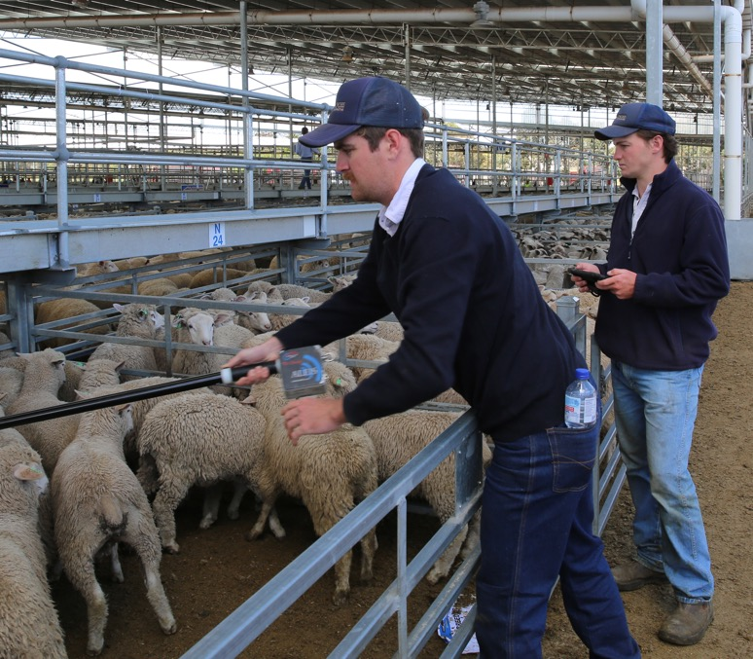
Answer
6
Lesson 2
From paddock to plate
To track the movements of individual cattle, sheep and goats

Slide 14
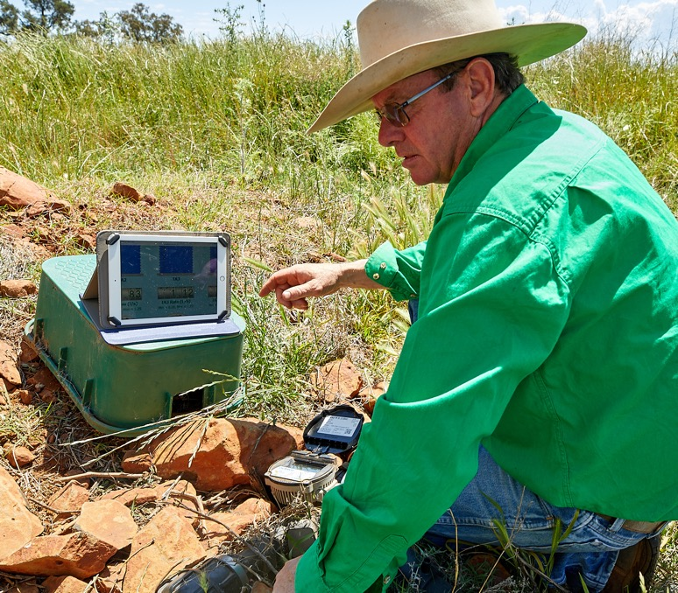
Question
7
Lesson 3
Safety, sustainability and technology
New innovations and technologies are used on farms to make jobs faster, safer, and easier.
How does the term prototype relate to technology and innovation?

Slide 15
Answer
7
Lesson 3
Safety, sustainability and technology
A prototype is the first version of a device, product, or technology.
This helps designers and engineers improve their ideas
to make farming more efficient and sustainable.

Slide 16
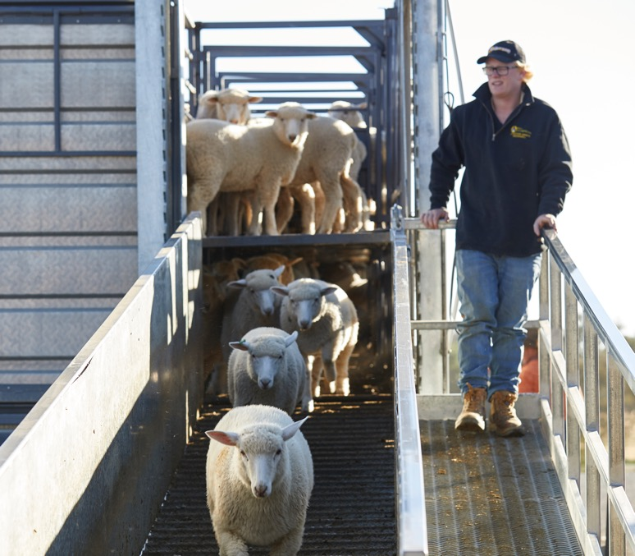
Question
8
Lesson 3
Safety, sustainability and technology
Safety is a major focus on farms where people work with machinery and animals.
Give one example of a technology that helps make farms safer for people or animals.

Slide 17
Answer
8
Lesson 3
Safety, sustainability and technology
Many possible answers, such as:
Autonomous tractors
Seatbelts and rollover protection systems on vehicles
SwagBot robots
The Numnuts device, which reduces pain and stress for lambs during marking and makes the process safer for the user by reducing needlestick injuries

Slide 18
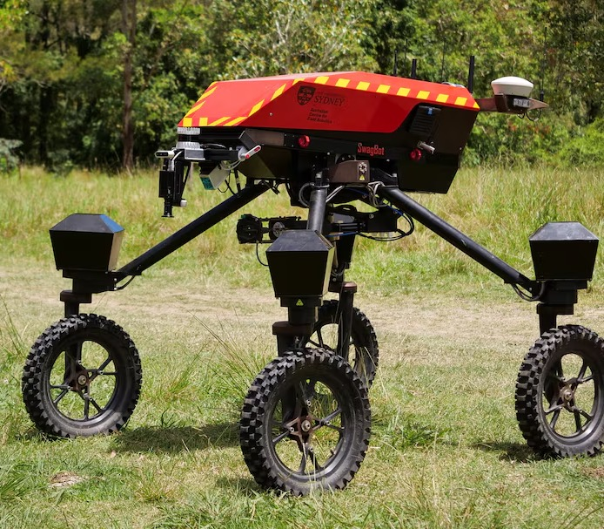
Question
9
Lesson 3
Safety, sustainability and technology
Red meat producers are exploring ways to make food and fibre production more efficient and environmentally sustainable by using robots.
What is SwagBot, and how does this technology assist producers on farms?

Slide 19
Answer
9
Lesson 3
Safety, sustainability and technology
SwagBot is a robotic prototype designed to help manage livestock by moving around the farm, herding animals, and even encouraging them to feed using voice recordings and visual cues.

Slide 20
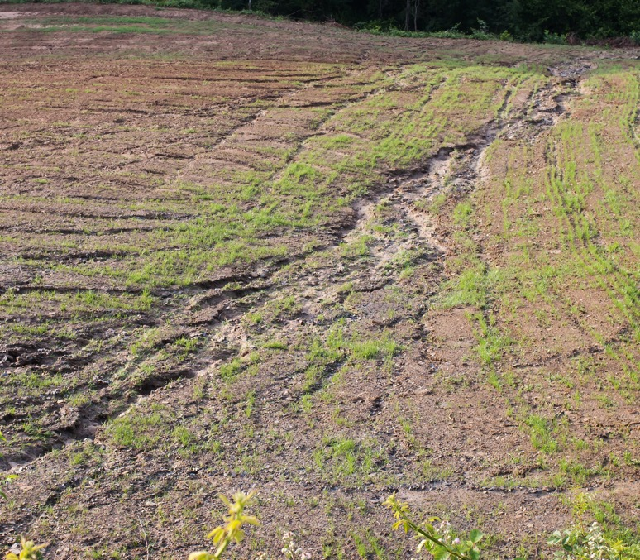
Question
10
Lesson 4
The farming environment
Farmers protect their soil in many ways so it does not wash or blow away.
What is groundcover?

Slide 21
Answer
10
Lesson 4
The farming environment
Low, spreading plants that protect the soil from erosion.

Slide 22
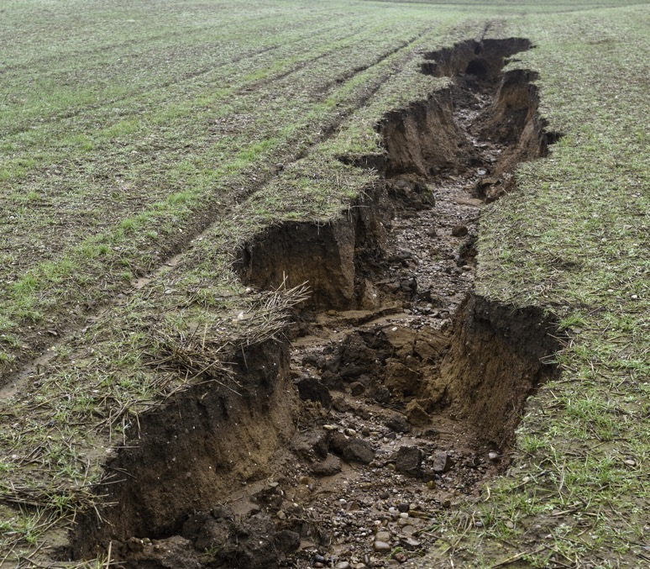
Question
11
Lesson 4
The farming environment
Australian red meat producers use different strategies (like maintaining groundcover) to prevent soil loss and improve the health of their farms.
Give one example of a farming practice that helps reduce erosion.

Slide 23
Answer
11
Lesson 4
The farming environment
Many possible answers, such as:
Planting trees to stabilise soil
Fencing off creeks and revegetating areas
Resting paddocks to allow recovery
Avoiding having too many animals in one paddock
Moving animals away from a paddock
and leaving some groundcover

Slide 24
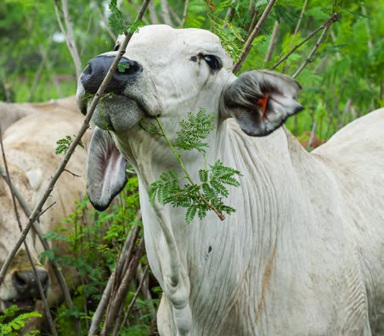
Question
12
Lesson 4
The farming environment
Some producers plant trees and legumes to protect the soil and feed livestock. This plant is called Leucaena and is grown on some farms.
Explain how large plants like Leucaena benefit both livestock
and the soil.

Slide 25
Answer
12
Lesson 4
The farming environment
Leucaena provides a high-protein, nutritious feed source for livestock.
Its roots help stabilise soil, reducing erosion.
Leucaena improves soil fertility and increases soil carbon and nitrogen levels.

Slide 26
Question
13
Lesson 5
Safe food preparation
People handle food every day, from shopping to cooking and eating.
What is food safety?

Slide 27
Answer
13
Lesson 5
Safe food preparation
Handling, preparing, and storing food in ways that reduce the risk of foodborne illness.

Slide 28
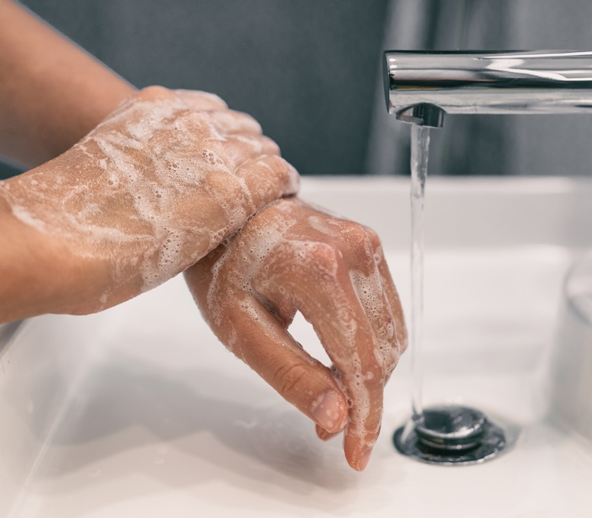
Question
14
Lesson 5
Safe food preparation
Good hygiene is essential
when preparing food.
What are two examples of hygiene practices that help prevent foodborne illness?

Slide 29
Answer
14
Lesson 5
Safe food preparation
Many possible answers, such as:
Washing hands regularly
Cleaning surfaces
Using clean utensils
Wearing gloves
Keeping raw and cooked foods separate

Slide 30
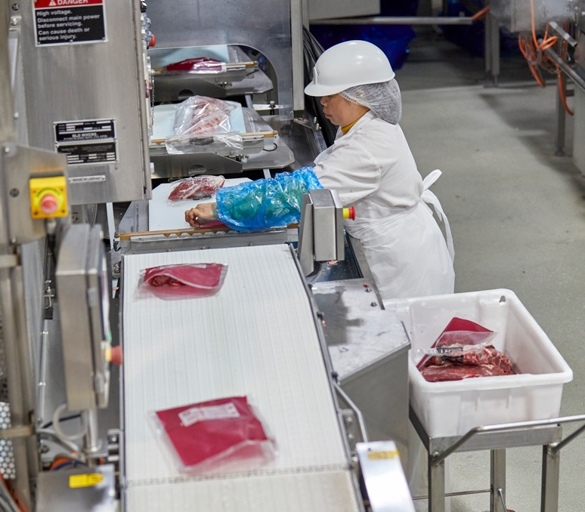
Question
15
Lesson 5
Safe food preparation
The red meat supply chain includes many stages where hygiene and food safety must be maintained.
Why is the National Livestock Identification System (NLIS) important for food safety?

Slide 31
Answer
15
Lesson 5
Safe food preparation
The NLIS records livestock movements through a national database, helping trace animals in cases of food safety or disease outbreaks.

Slide 32
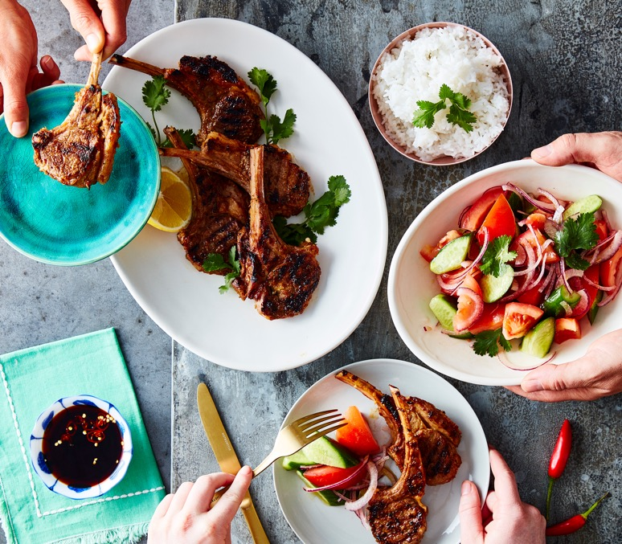
Question
16
Lesson 6
Healthy eating and nutrition
A healthy, balanced diet includes eating lean red meat.
Which is not an example
of red meat?
Goatmeat
Lamb
Chicken
Beef

Slide 33
Answer
16
Lesson 6
Healthy eating and nutrition
Chicken

Slide 34
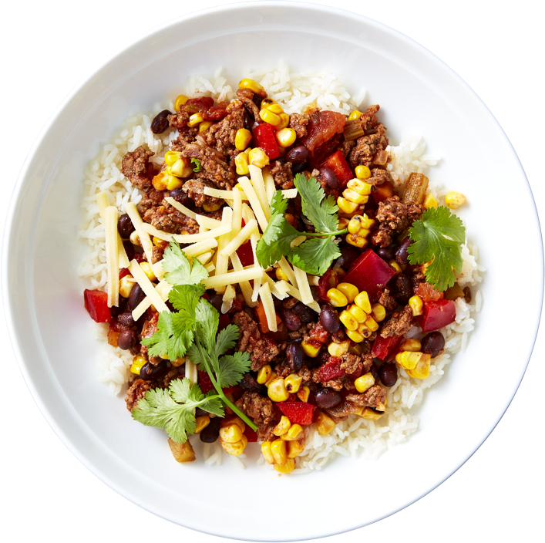
Question
17
Lesson 6
Healthy eating and nutrition
A healthy, balanced diet includes eating lean red meat 3-4 times a week paired with a variety of foods like vegetables and legumes/beans.
Name the five food groups.

Slide 35
Answer
17
Lesson 6
Healthy eating and nutrition
Vegetables and legumes (beans)
Fruit
Cereals and grains
Lean meat, poultry, fish, eggs, legumes (beans), tofu, nuts, seeds
Dairy, such as milk, cheese, yoghurt or alternatives

Slide 36
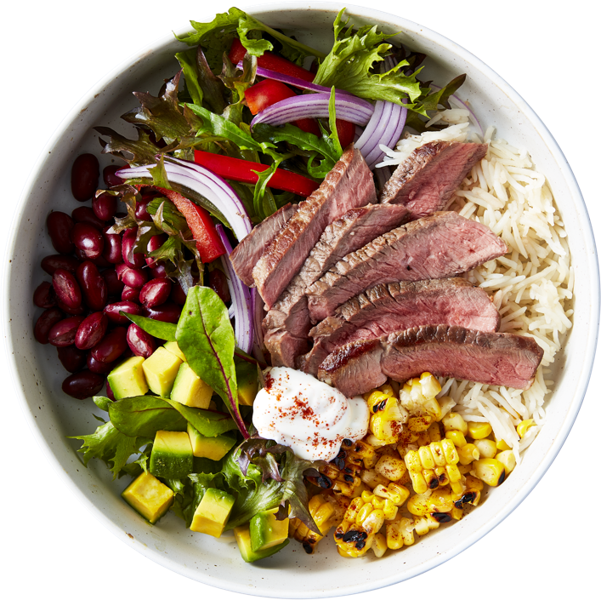
Question
18
Lesson 6
Healthy eating and nutrition
The Australian Dietary Guidelines recommend the number of standard serves of the five food groups you should consume each day.
How much lean red meat (meat with
the fat trimmed off) is recommended
per week?
55g
1055g
455g

Slide 37
Answer
18
Lesson 6
Healthy eating and nutrition
455g

Slide 38
Scan the QR code to access a range of Australian
Curriculum-aligned 5–6 learning resources.
Lessons • Student resources • Classroom posters • Paddock to plate card game • Teaching video
© Meat & Livestock Australia 2026. MLA Australian Good Meat Education has been developed with specialist education services of the Primary Industries Education Foundation Australia. This educational resource is provided under a Creative Commons Licence CC-BY-SA 4.0.

