Slide 1
Hats and boots
Year 7 – Year 8
Teacher presentation
Play a tic-tac-toe-style game focused on sustainable cattle, sheep and goat production.
© Meat & Livestock Australia 2026. MLA Australian Good Meat Education has been developed with specialist education services of the Primary Industries Education Foundation Australia. This educational resource is provided under a Creative Commons Licence CC-BY-SA 4.0.

Slide 2
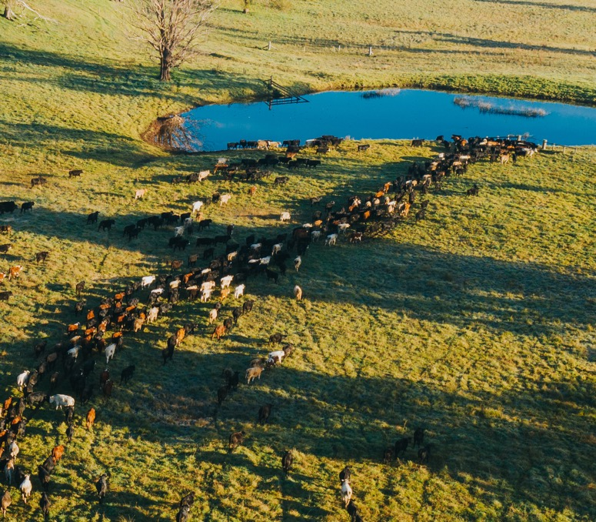
Question
1
Lesson 1
Managing sustainable red meat production
Access to good-quality water is essential for successful food and fibre production.
How much water do cattle consume per day, per head?
3–7 litres
306–478 litres
22–85 litres
70–103 litres

Slide 3
Answer
1
Lesson 1
Managing sustainable red meat production
Between 22 and 85 litres

Slide 4
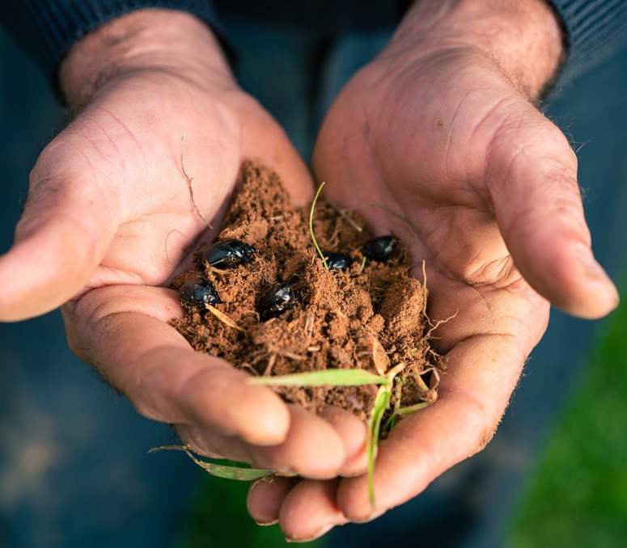
Question
2
Lesson 1
Managing sustainable red meat production
Encouraging biodiversity on farms is important to environmental sustainability. Dung beetles are an important soil organism.
Why are dung beetles important in farming ecosystems?

Slide 5
Answer
2
Lesson 1
Managing sustainable red meat production
They break down faeces and recycle nutrients back in the
soil ecosystem.
They also remove a food source for flies, keeping their numbers limited, helping to reduce flystrike.

Slide 6
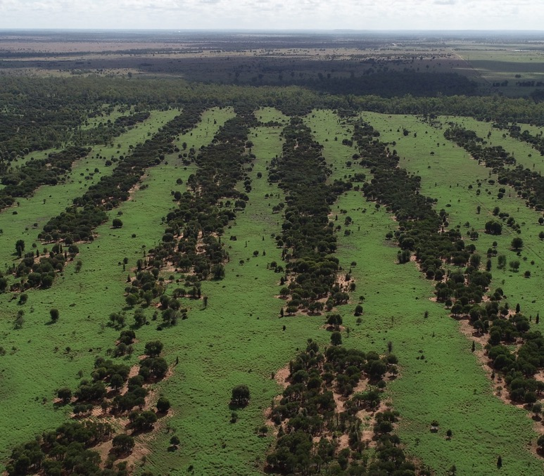
Question
3
Lesson 1
Managing sustainable red meat production
Environmental sustainability is essential to productive red meat farms. Producers need to consider managing their carbon inputs and outputs.
What do the letters ‘GHG’ represent in relation to environmental sustainability?

Slide 7
Answer
3
Lesson 1
Managing sustainable red meat production
Greenhouse gas (emissions)

Slide 8
Question
4
Lesson 2
Feeding strategies
and product quality
Pastures are balanced communities of plants that provide grazing animals with food. There are many different types of pastures in Australia. They can be native, exotic/introduced, or improved pastures.
What is one difference between native and introduced pastures?

Slide 9
Answer
4
Lesson 2
Feeding strategies
and product quality
Native pastures originate in Australia, whereas introduced pastures were brought to Australia from overseas.
Introduced pastures often have higher nutritional value than native pastures.
Native pastures have thin fibrous leaves compared to introduced pastures.

Slide 10
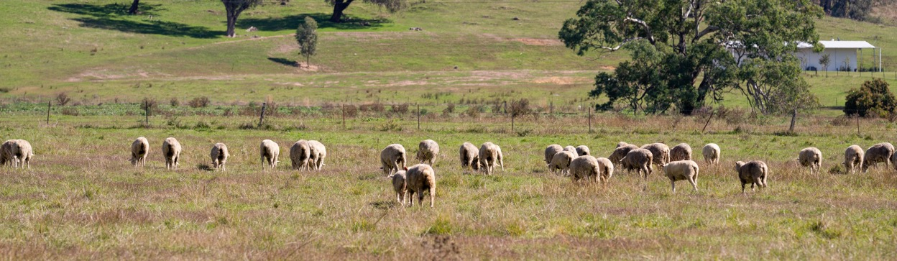
Question
5
Lesson 2
Feeding strategies
and product quality
Cattle and sheep in Australia consume different types of plants and pastures. What they consume will depend on where they live and their intended market (or market specifications).
Which of these are native pasture plants?
Wheat
Clover
Cottonseed
Salt bush

Slide 11
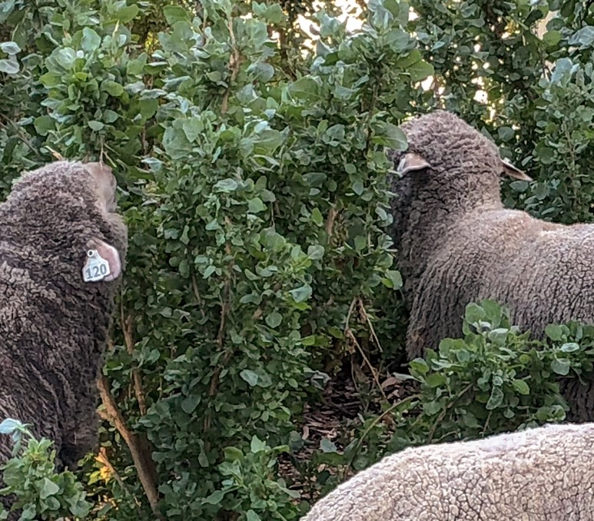
Answer
5
Lesson 2
Feeding strategies
and product quality
Salt bush

Slide 12
Question
6
Lesson 2
Feeding strategies
and product quality
Grains, such as barley, wheat and sorghum, are often given to beef cattle to increase weight and fat deposition (or content) prior to processing.
What is the name of the place where beef cattle are fed a specialised diet?

Slide 13
Answer
6
Lesson 2
Feeding strategies
and product quality
Feedlot

Slide 14
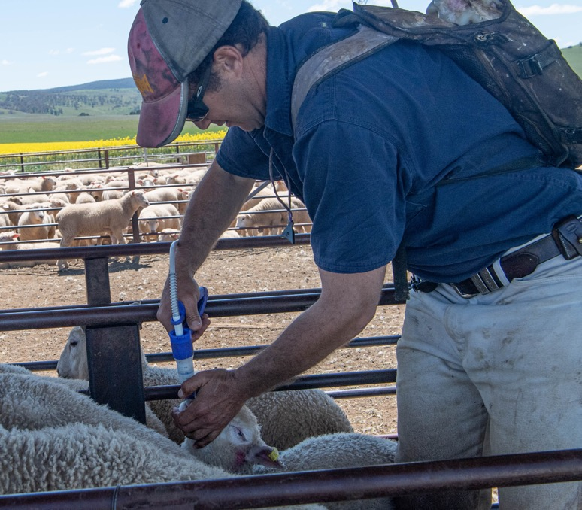
Question
7
Lesson 3
Management of plants and animals
Protecting sheep, cattle and goats from pests and diseases is important to productivity and efficiency.
Drenching is an example of
which type of pest and disease management?
Biological control
Chemical control
Genetic control
Robotic control

Slide 15
Answer
7
Lesson 3
Management of plants and animals
Chemical control

Slide 16
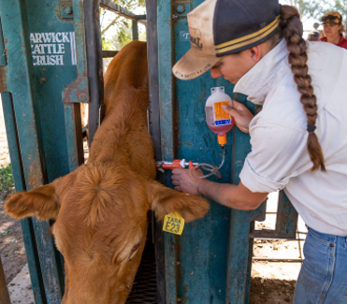
Question
8
Lesson 3
Management of plants and animals
Beef cattle in Australia can be vaccinated with a 5 in 1 or 7 in 1 injection that protects them from
a number of serious diseases.
Which of the following is
the approximate cost of a vaccination dosage?
$35.60
$2.35
$27
$11.43

Slide 17
Answer
8
Lesson 3
Management of plants and animals
$2.35

Slide 18
Question
9
Lesson 3
Management of plants and animals
Quarantine is an important way of protecting the food and fibre industry.
What is quarantine, and why is it important?

Slide 19
Answer
9
Lesson 3
Management of plants and animals
Quarantine is a biosecurity measure for imported goods, plants, and animals, designed to prevent the entry of exotic pests and diseases into Australia and between states and territories.
Quarantine protects Australia’s agriculture and environment from high-risk, foreign pests
and diseases.

Slide 20
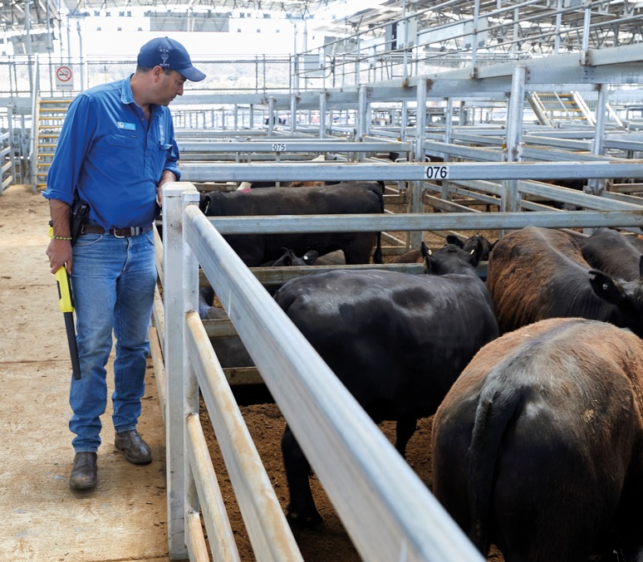
Question
10
Lesson 4
Where does Australian red meat go?
Australia’s red meat and livestock industry is very important to the Australian economy.
Australia's red meat and livestock industry employed how many people in 2023-2024?
460,272
460,556
460,778
460,385

Slide 21
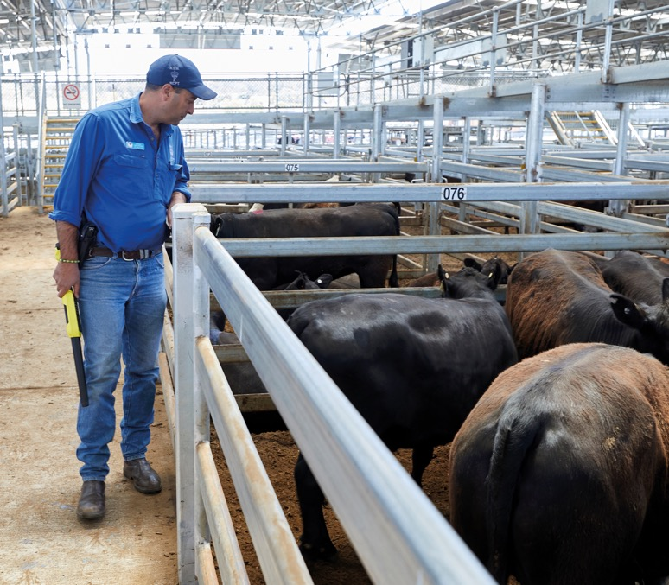
Answer
10
Lesson 4
Where does Australian red meat go?
460,272

Slide 22
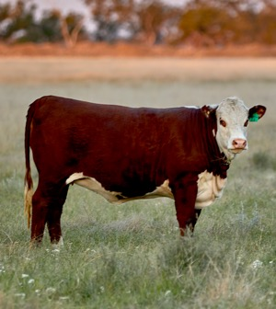
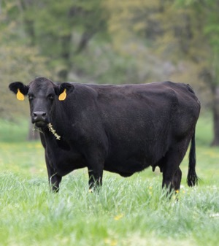
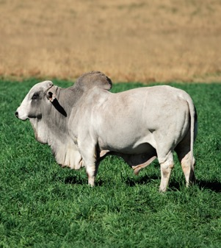
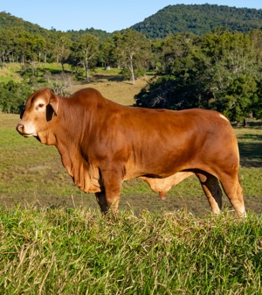
Question
11
Lesson 4
Where does Australian red meat go?
Bos taurus breeds originate from the temperate climate of Europe and are better suited to southern Australia (cooler climates with higher rainfall).
Bos indicus breeds originate from southern Asia (hot climate, seasonal rain with high humidity). They have loose skin and tolerate high temperatures without getting stressed.
Name a breed of cattle that is Bos taurus and a breed of cattle that is Bos indicus.

Slide 23
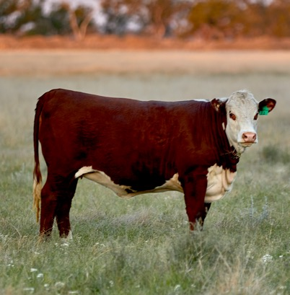
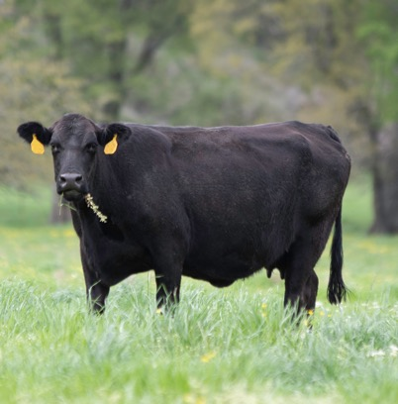
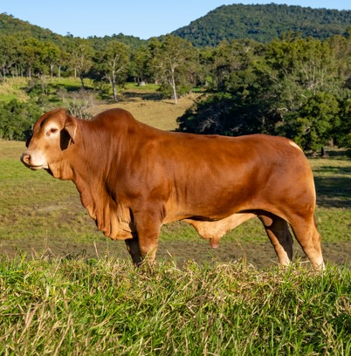
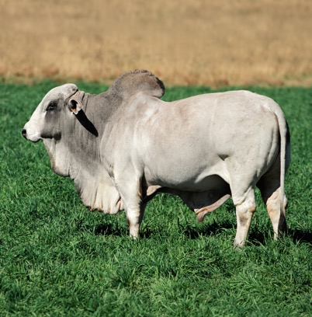
Answer
11
Lesson 4
Where does Australian red meat go?
Bos taurus
Bos indicus
Hereford
Angus
Droughtmaster
Brahman

Slide 24
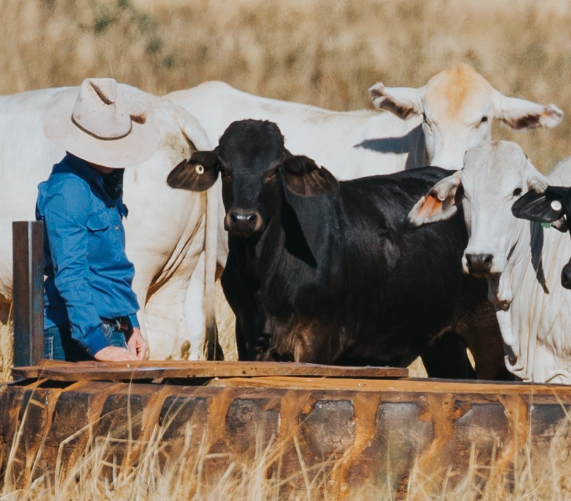
Question
12
Lesson 4
Where does Australian red meat go?
The types of cattle, sheep and goats farmed in different regions of Australia depend on the breed's adaptations, the climatic conditions and the environment of the area.
Which state or territory is the highest producer of sheep in Australia, and which is the
highest producer of cattle?

Slide 25
Answer
12
Lesson 4
Where does Australian red meat go?
New South Wales – sheep
Queensland – cattle

Slide 26
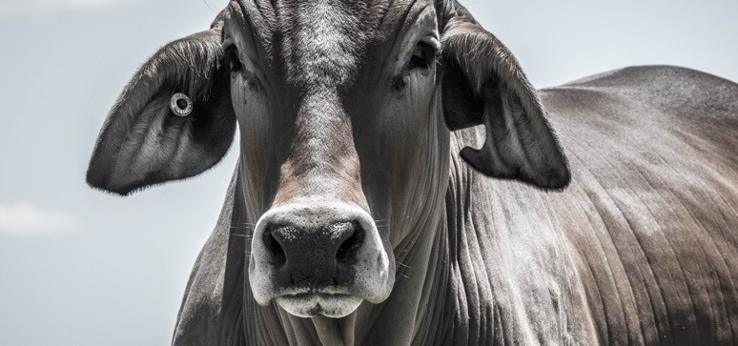
Question
13
Lesson 5
From paddock to plate
Technology is used throughout the red meat supply chain to improve economic, environmental and social sustainability.
What is the National Livestock Identification System (NLIS)
used for in the red meat supply chain?
Traceability
Tracking production data
On-farm management of cattle
All of the above

Slide 27
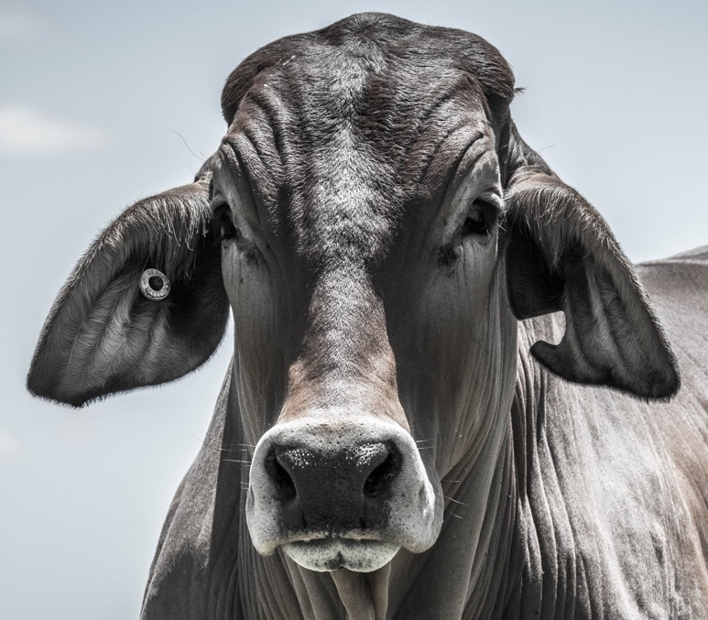
Answer
13
Lesson 5
From paddock to plate
All of the above

Slide 28
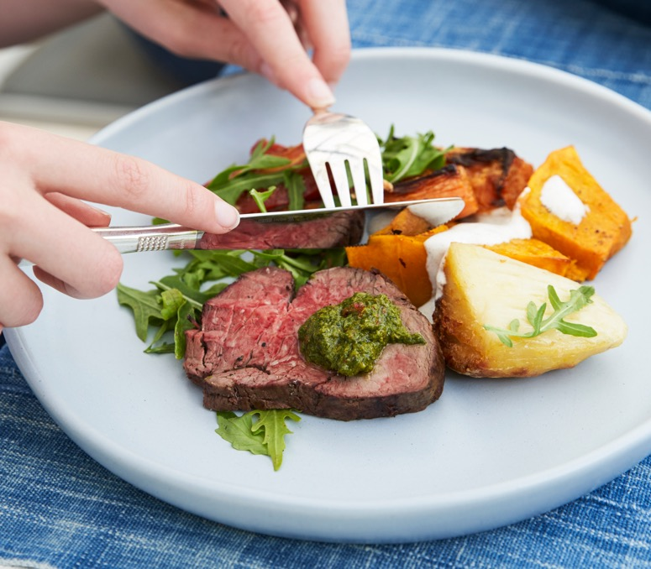
Question
14
Lesson 5
From paddock to plate
There are various stages involved in the paddock to plate red meat supply chain.
Name three of the red meat supply chain stages.

Slide 29
Answer
14
Lesson 5
From paddock to plate
Any three of the following:
Farm (paddock)
Feedlot
Saleyards
Holding yards and abattoir
Packaging and cold store
Export market
Export retail and food service
Domestic market
Consumer (plate)

Slide 30
Question
15
Lesson 5
From paddock to plate
Robotic processing is used in the processing/abattoir stage of the supply chain. This technology automates the processing and objective measurement of the rib cutting process.
Explain why automation is an advantage in the supply chain.

Slide 31
Answer
15
Lesson 5
From paddock to plate
Automation allows the industry to remain
competitive, with increased efficiency and
decreasing labour costs.
This technology has improved safety by removing human interaction with a hand circular saw and improved the consistency of cutting through scanning and X-ray technology.
It also strengthens quality control, ensuring a consistent product that meets retail and consumer expectations.

Slide 32
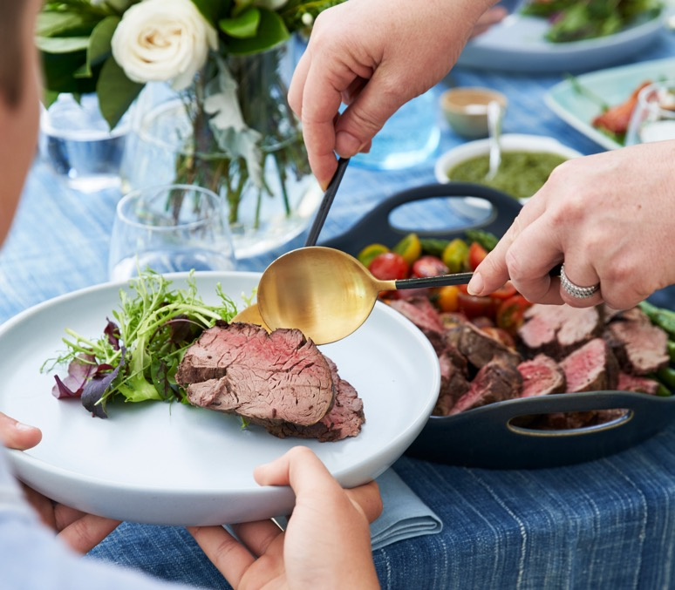
Question
16
Lesson 6
Compliments to the
chef and the producers!
There are many cuts of red meat that are eaten by consumers.
Which of the following is not an example of a cut of red meat?
Breast
Top side
Cube roll
Brisket

Slide 33
Answer
16
Lesson 6
Compliments to the
chef and the producers!
Breast

Slide 34
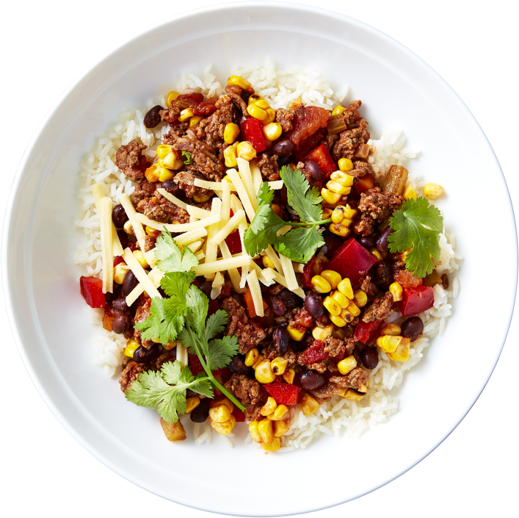
Question
17
Lesson 6
Compliments to the
chef and the producers!
The Australian Dietary Guidelines recommend the number of standard serves from the five food groups that we should consume each day.
According to the Australian Dietary Guidelines, how many serves of lean meat, fish, poultry, eggs, nuts, seeds and legumes/beans should the average male and female adolescent eat each day?

Slide 35
Answer
17
Lesson 6
Compliments to the
chef and the producers!
2.5

Slide 36
Question
18
Lesson 6
Compliments to the
chef and the producers!
Cuts of meat refer to the specific parts of a carcase that are used for consumption. These cuts are given classifications relating to the carcase location that the cut is taken from.
What are primal cuts of meat?

Slide 37
Answer
18
Lesson 6
Compliments to the
chef and the producers!
Primal cuts are the primary divisions of a carcase made
during processing.
They represent the large sections from which all other smaller cuts are derived. These cuts are typically too large for direct sale to consumers and require further processing to create smaller cuts more suitable
for retail sale and consumption.

Slide 38
Scan the QR code to access a range of Australian
Curriculum-aligned 7–8 learning resources.
Lessons • Student resources • Classroom posters • Paddock to plate card game • Teaching video
© Meat & Livestock Australia 2026. MLA Australian Good Meat Education has been developed with specialist education services of the Primary Industries Education Foundation Australia. This educational resource is provided under a Creative Commons Licence CC-BY-SA 4.0.

