Slide 1
Hats and boots
Year 9 – Year 10
Teacher presentation
Play a tic-tac-toe-style game focused on sustainable cattle, sheep and goat production.
© Meat & Livestock Australia 2026. MLA Australian Good Meat Education has been developed with specialist education services of the Primary Industries Education Foundation Australia. This educational resource is provided under a Creative Commons Licence CC-BY-SA 4.0.

Slide 2
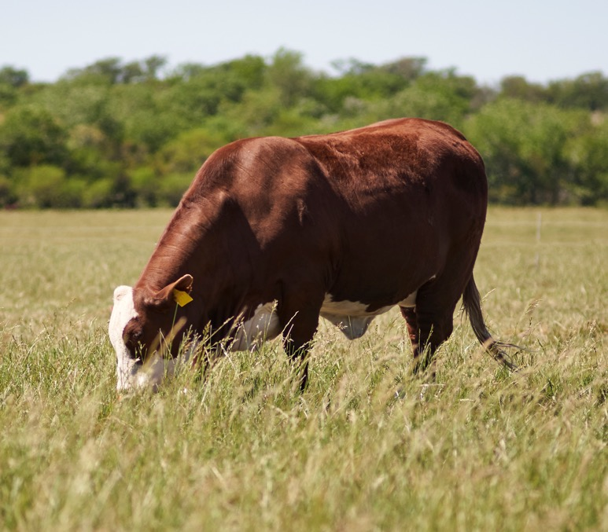
Question
1
Lesson 1
Intensive and extensive production systems
Plants and animals depend on each other in agricultural systems.
What two things do plants provide that animals require for survival?

Slide 3
Answer
1
Lesson 1
Intensive and extensive production systems
Oxygen and energy source

Slide 4
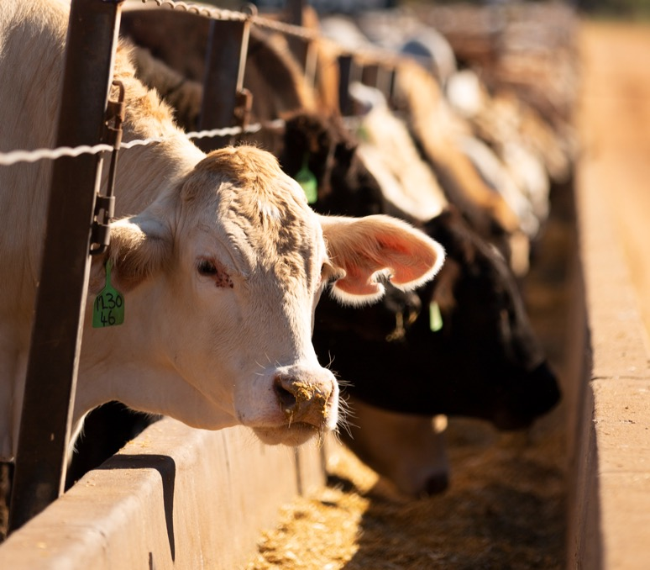
Question
2
Lesson 1
Intensive and extensive production systems
Feedlots allow producers to manage cattle in controlled conditions.
What is a feedlot, and what type
of production system does it represent?

Slide 5
Answer
2
Lesson 1
Intensive and extensive production systems
A confined yard where large numbers of cattle are fed a specific grain-based ration.
It is an example of an intensive agricultural system.

Slide 6
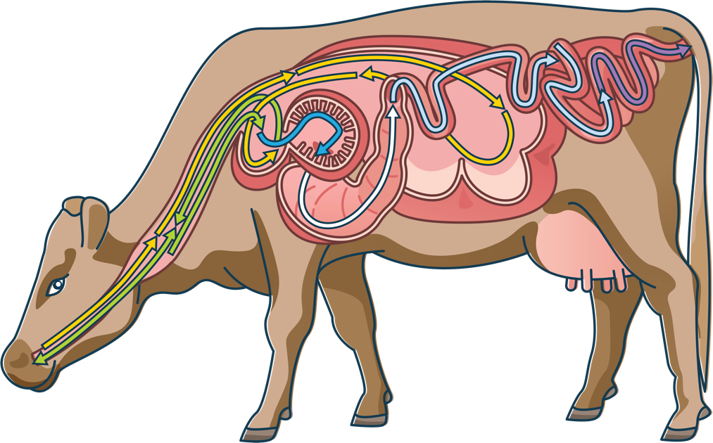
Question
3
Lesson 1
Intensive and extensive production systems
Ruminant animals have a specialised digestive system to process roughage.
Name the four stomach compartments of a ruminant digestive system.

Slide 7
Answer
3
Lesson 1
Intensive and extensive production systems
Rumen
Reticulum
Omasum
Abomasum

Slide 8
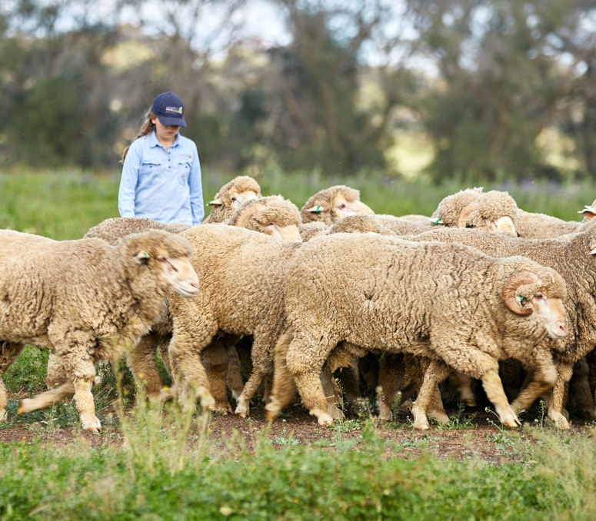
Question
4
Lesson 2
Animal welfare considerations
Producers rely on productive animals for successful food and fibre production.
Why is it important for producers to care for the welfare of their animals.

Slide 9
Answer
4
Lesson 2
Animal welfare considerations
High standards of animal welfare result in productive animals that are not stressed, injured or diseased. These factors all contribute to the eating quality of the end product.

Slide 10
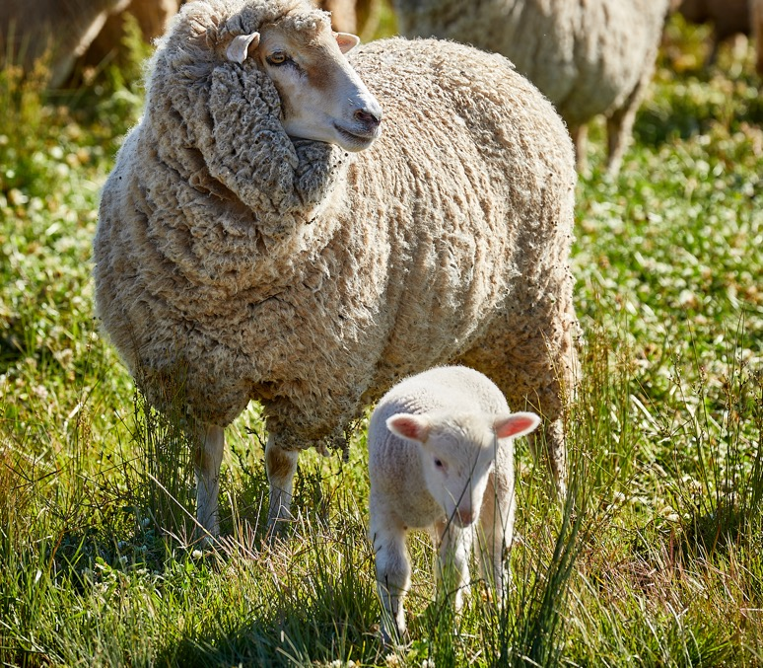
Question
5
Lesson 2
Animal welfare considerations
Husbandry practices are important for managing and maintaining sheep health.
Why is tail docking performed on lambs?

Slide 11
Answer
5
Lesson 2
Animal welfare considerations
To reduce faecal and urine staining around the tail area and therefore decrease the risk of blowfly strike.

Slide 12
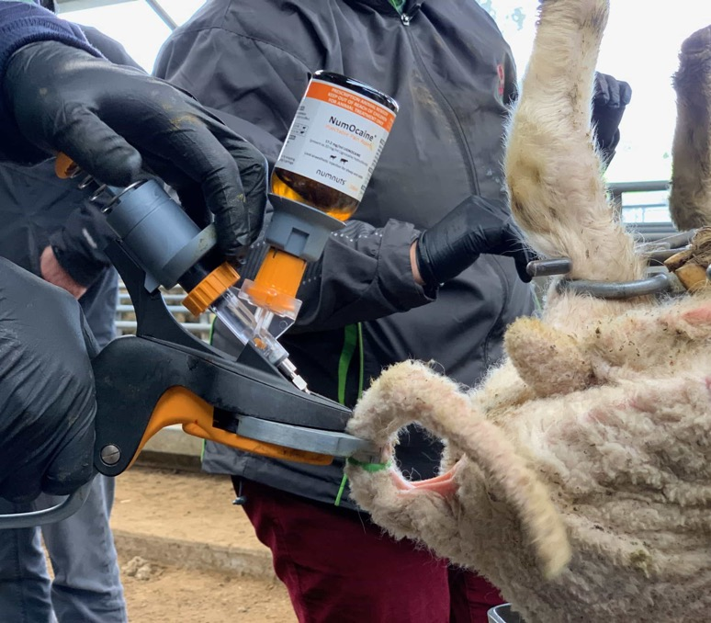
Question
6
Lesson 2
Animal welfare considerations
New technologies are being developed by the meat and livestock industry to improve animal welfare outcomes.
What is an advantage of using
the Numnuts® technology?

Slide 13
Answer
6
Lesson 2
Animal welfare considerations
Answer may include:
Reducing the pain experienced by lambs during tail docking and castration
Safer handing and management for producers

Slide 14
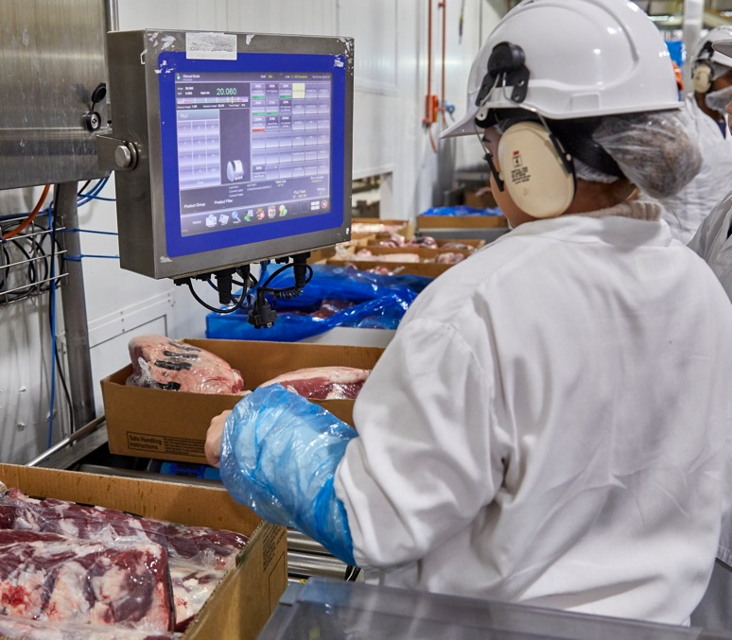
Question
7
Lesson 3
The marketing and supply chain
Australia has a global reputation for producing high-quality, trusted red meat products underpinned by its large export market value.
True or false:
The international market is the largest market for Australian
beef and sheepmeat.

Slide 15
Answer
7
Lesson 3
The marketing and supply chain
True
Australia's international market for beef and sheepmeat represents around 70% of overall national production.

Slide 16
Question
8
Lesson 3
The marketing and supply chain
Australia’s red meat supply chain involves many people working across different stages from paddock to plate.
Name two occupations involved in the red meat supply chain.

Slide 17
Answer
8
Lesson 3
The marketing and supply chain
Answer many include
(but not limited to) the following:
Producer
Farm hand
Truck driver
Auctioneer
Stock agent
Feedlot manager
Feedlot worker
Processor
Butcher/retailer
Chef

Slide 18
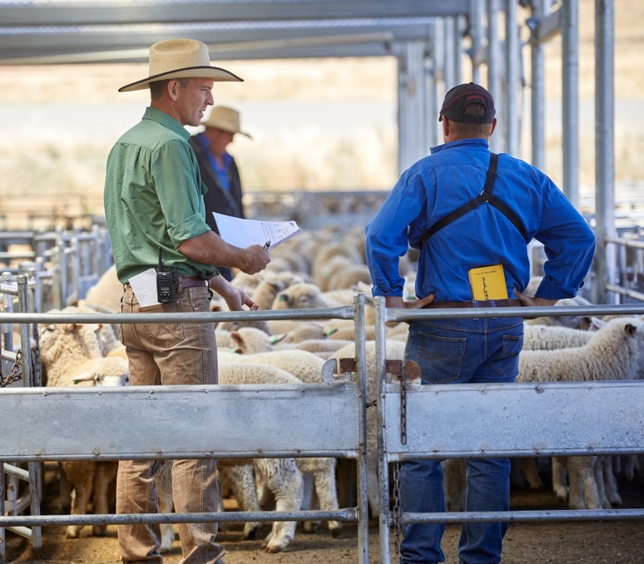
Question
9
Lesson 3
The marketing and supply chain
There are various methods for selling sheep, cattle and goats in Australia.
Which of these is not a selling system for livestock in Australia?
AuctionsPlus
Over-the-hooks
Saleyard
Feedlot finishing

Slide 19
Answer
9
Lesson 3
The marketing and supply chain
Feedlot finishing

Slide 20
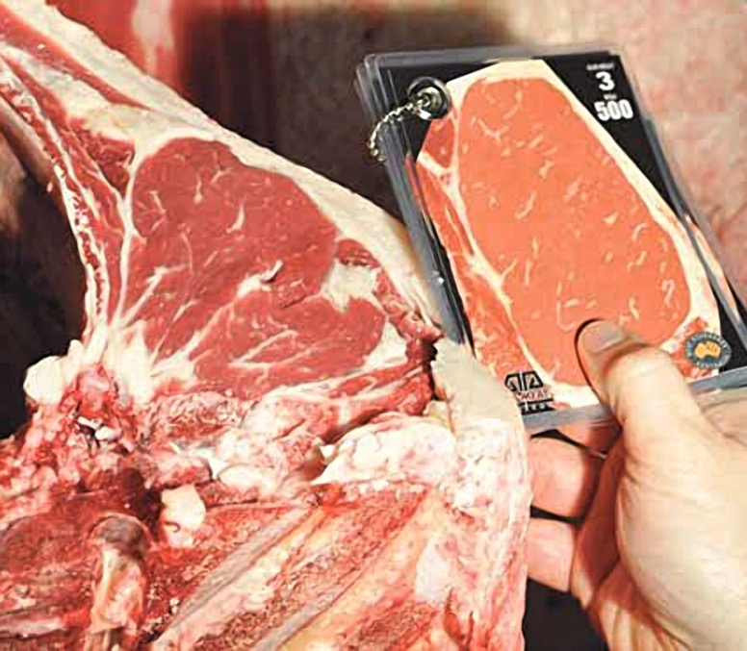
Question
10
Lesson 4
Assessment and advertising
Consumers prefer certain visual qualities in meat.
Which meat colour do most consumers prefer to purchase?
Very dark red
Pale brown
Bright pink to cherry red

Slide 21
Answer
10
Lesson 4
Assessment and advertising
Bright pink to cherry red

Slide 22
Question
11
Lesson 4
Assessment and advertising
Meat Standards Australia (MSA) uses a range of measurements to improve the eating quality consistency of beef and sheepmeat.
What are two specifications that MSA graders assess?

Slide 23
Answer
11
Lesson 4
Assessment and advertising
Two of the following:
Carcase weight
Rib fat depth
Marbling
Meat colour
Fat colour
Eye muscle area
Ossification

Slide 24
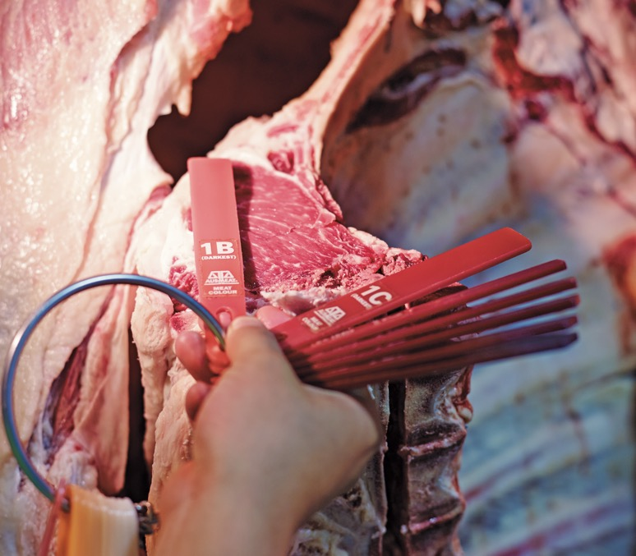
Question
12
Lesson 4
Assessment and advertising
On-farm management practices are a critical factor that influences the quality of the end product.
How does minimising stress affect meat colour?

Slide 25
Answer
12
Lesson 4
Assessment and advertising
Minimising stress before processing helps maintain optimal pH levels in an animal’s muscles, resulting in a bright cherry red meat colour.
In contrast, animals that experience high stress prior to processing often exhibit darker red meat, which is caused by elevated muscle pH levels.

Slide 26
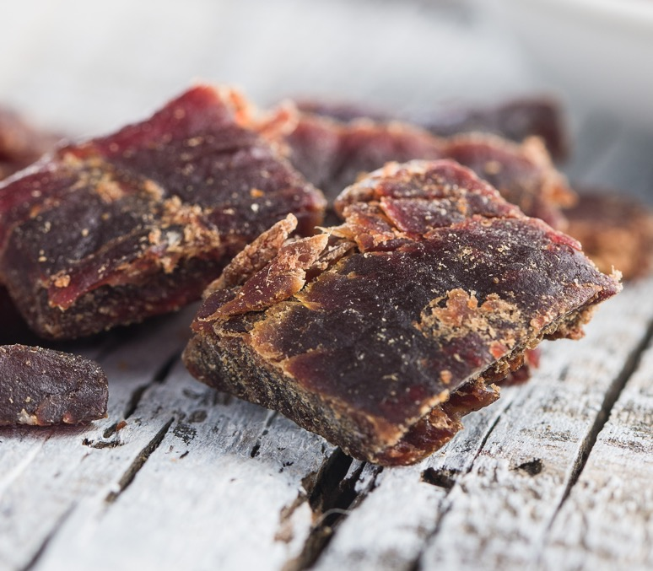
Question
13
Lesson 5
Preserving and preventing waste
Producers and processors use several methods to reduce food waste.
Name one way food waste can be reduced in the red meat supply chain.

Slide 27
Answer
13
Lesson 5
Preserving and preventing waste
Two of the following:
Optimising storage
Improved packaging
Using by-products efficiently
Alternative products
Nose-to-tail eating

Slide 28
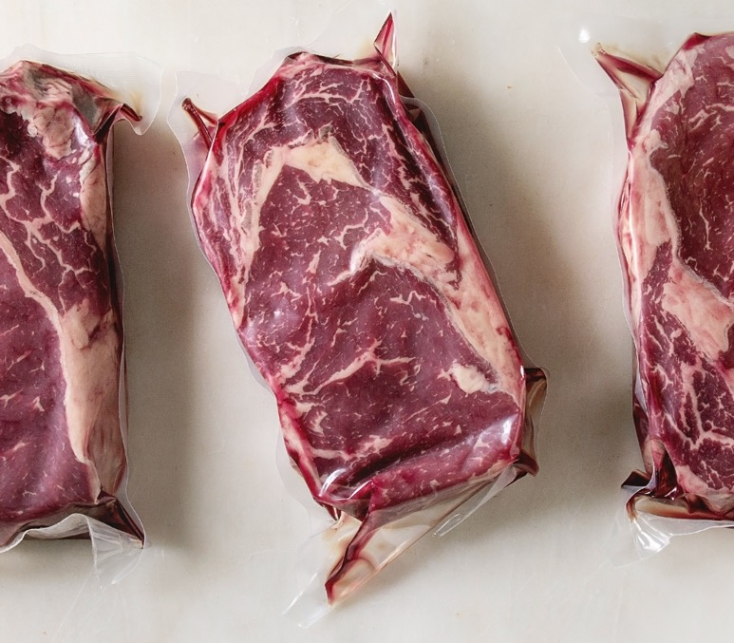
Question
14
Lesson 5
Preserving and preventing waste
Red meat can remain fresh for an extended period of time when packaged and stored in certain ways.
How does vacuum packaging help extend shelf life?

Slide 29
Answer
14
Lesson 5
Preserving and preventing waste
Removing oxygen slows bacterial growth, keeping it fresher for longer.

Slide 30
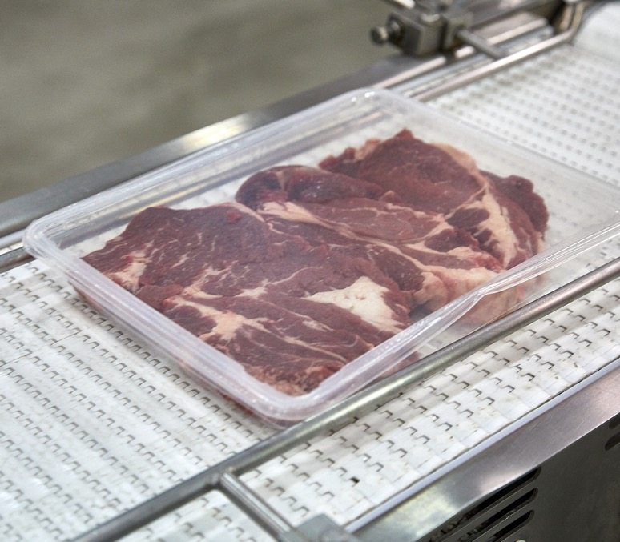
Question
15
Lesson 5
Preserving and preventing waste
Red meat preservation uses different techniques to stop microorganisms from growing and causing spoilage.
Name two traditional or modern methods used to preserve red meat.

Slide 31
Answer
15
Lesson 5
Preserving and preventing waste
Two of the following:
Chilling/refrigeration
Freezing
Salting/curing
Drying/dehydration
Smoking
Canning
Vacuum packaging
Modified atmosphere packaging
High-pressure processing

Slide 32
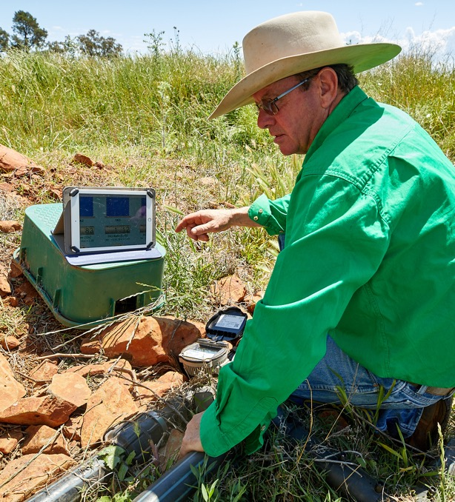
Question
16
Lesson 6
Emerging production technologies
Technology plays a major role in improving decision-making and management on farms.
Which of the following types of data help producers better manage the pastures grown on their farm?
Soil temperature
Animal growth rates
Rainfall patterns
All of the above

Slide 33
Answer
16
Lesson 6
Emerging production technologies
All of the above

Slide 34
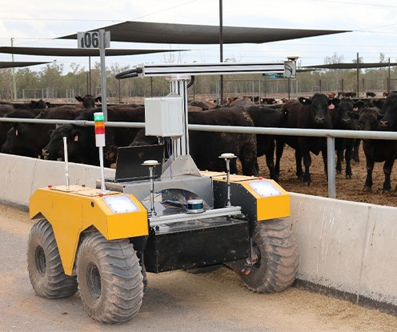
Question
17
Lesson 6
Emerging production technologies
New innovations help the red meat industry improve how animals,
land and resources are managed.
What is the aim of BunkBot technology?
To monitor movement
of animals in the pen
To manage and monitor feed
distribution and consumption
To deliver water to the troughs
To scan the liveweight of the animals

Slide 35
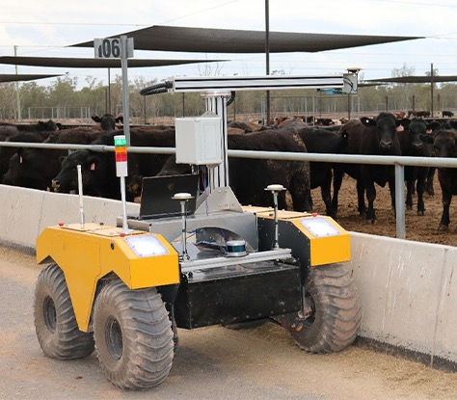
Answer
17
Lesson 6
Emerging production technologies
To manage and monitor feed distribution and consumption in the pen

Slide 36
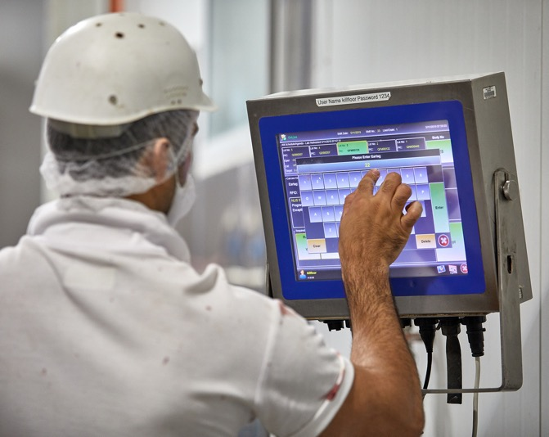
Question
18
Lesson 6
Emerging production technologies
New technologies aim to improve
efficiency across the red meat supply chain.
How does x-ray processing technology
improve productivity in abattoirs?
It increases the number of animals
that can be transported
It lowers the temperature
in processing rooms
Ensures accurate cuts for greater efficiency, less waste and consistent product quality that meets consumer expectations.

Slide 37
Answer
18
Lesson 6
Emerging production technologies
It ensures cut accuracy for improved efficiencies, waste reduction and creates a consistent end-product to meet retail and consumer expectations.

Slide 38
Scan the QR code to access a range of Australian
Curriculum-aligned 9–10 learning resources.
Lessons • Student resources • Classroom posters • Paddock to plate card game • Teaching video
© Meat & Livestock Australia 2026. MLA Australian Good Meat Education has been developed with specialist education services of the Primary Industries Education Foundation Australia. This educational resource is provided under a Creative Commons Licence CC-BY-SA 4.0.

