Slide 1
Hats and boots
Foundation – Year 2
Teacher presentation
Play a tic-tac-toe-style game focused on sustainable cattle, sheep and goat production.
© Meat & Livestock Australia 2026. MLA Australian Good Meat Education has been developed with specialist education services of the Primary Industries Education Foundation Australia. This educational resource is provided under a Creative Commons Licence CC-BY-SA 4.0.

Slide 2
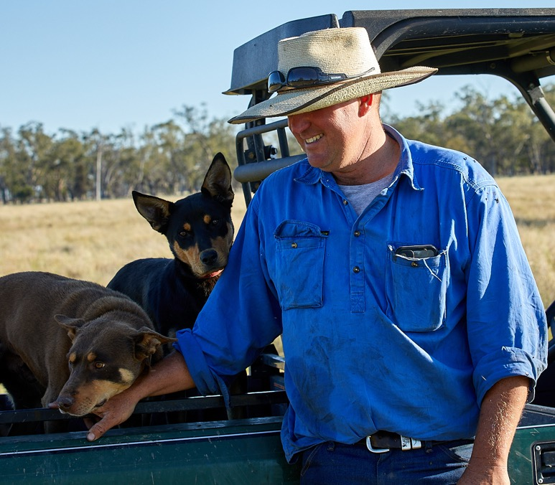
Question
1
Lesson 1
Seasons and jobs on the farm
Farmers perform different jobs throughout the year.
Name the four seasons.

Slide 3
Answer
1
Lesson 1
Seasons and jobs on the farm
Summer
Autumn
Winter
Spring

Slide 4
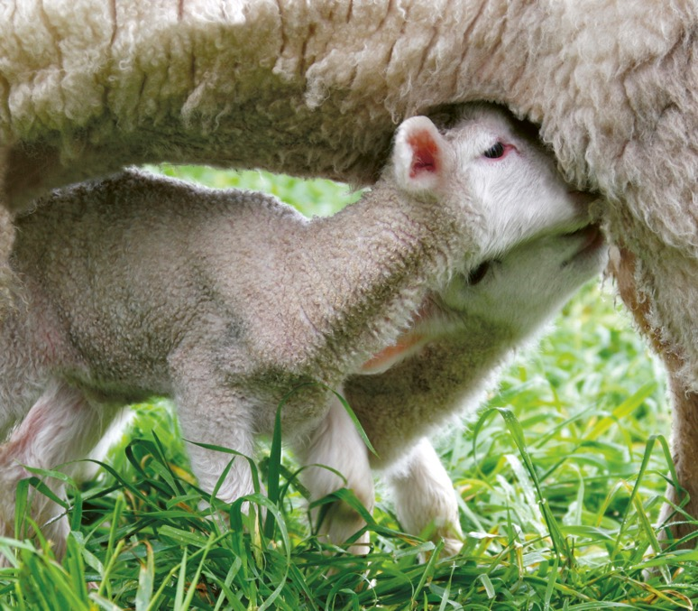
Question
2
Lesson 1
Seasons and jobs on the farm
Seasons are important when producing food for people to eat
and fibre for people to use.
What does the word
‘seasons’ mean?

Slide 5
Answer
2
Lesson 1
Seasons and jobs on the farm
The times or cycles of the year,
in which many places in the
world experience different
weather conditions.

Slide 6
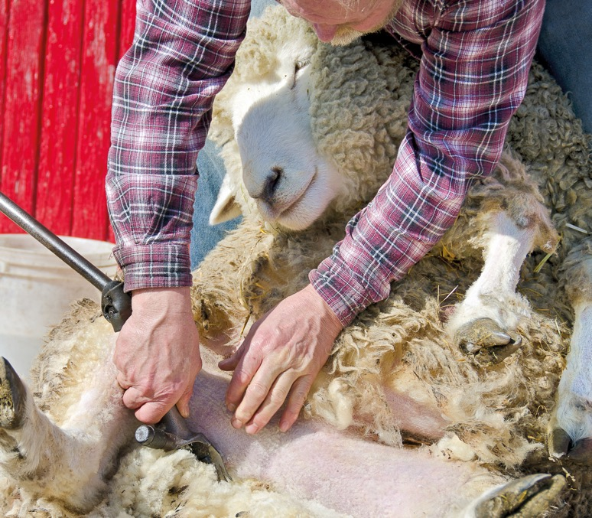
Question
3
Lesson 1
Seasons and jobs on the farm
Crutching is the practice of cutting or shearing wool from around the sheep's bottom to keep the area clean.
Which season is crutching most commonly performed in?

Slide 7
Answer
3
Lesson 1
Seasons and jobs on the farm
Winter

Slide 8
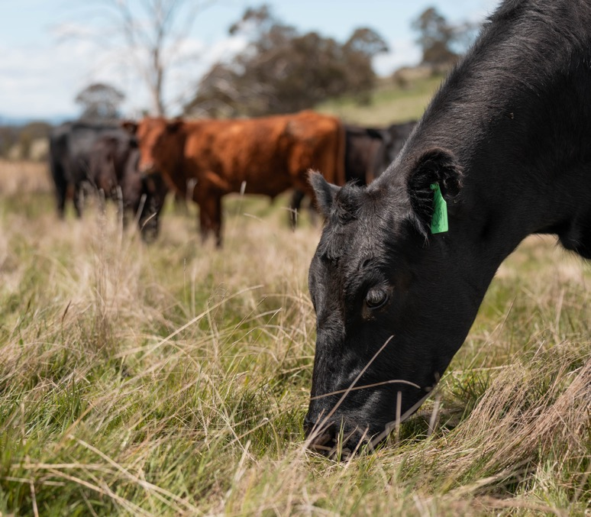
Question
4
Lesson 2
Who lives on the farm?
Humans have a stomach with one compartment. Sheep, cattle and
goats are ruminants, which means they have more compartments.
How many stomach compartments do ruminants have?
2
4
9

Slide 9
Answer
4
Lesson 2
Who lives on the farm?
4

Slide 10
Question
5
Lesson 2
Who lives on the farm?
Living things have needs to survive and be healthy. Farmers meet the needs of their plants and animals.
Name three needs of living things.

Slide 11
Answer
5
Lesson 2
Who lives on the farm?
Any three of the following:
Food
Shelter
Water
Air

Slide 12
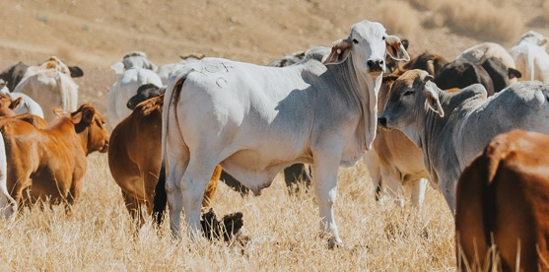
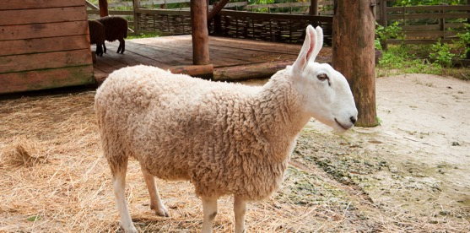
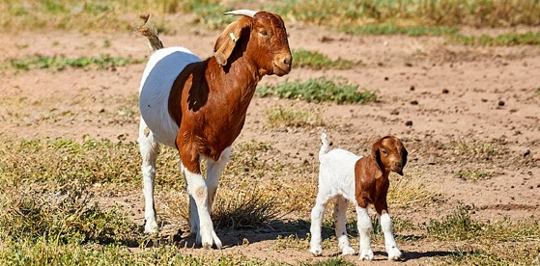
Question
6
Lesson 2
Who lives on the farm?
Cattle, sheep and goats are livestock that are produced on
Australian farms. There are many different breeds of livestock
that are used for food and fibre.
Match each picture to the name of a breed of sheep, cattle, or goat.
Boer
Border Leicester
Brahman
1
2
3

Slide 13
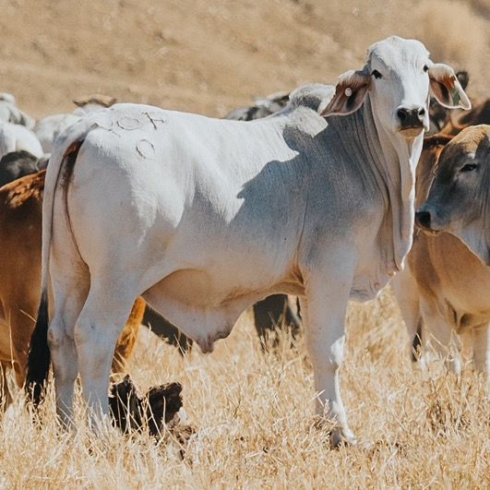
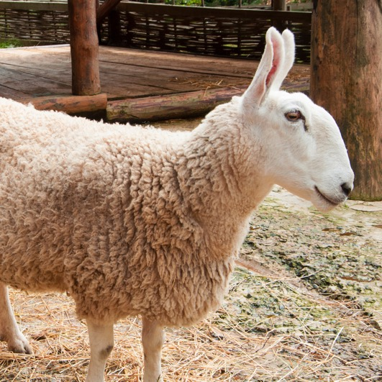
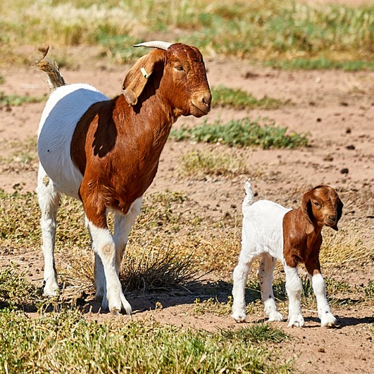
Answer
6
Lesson 2
Who lives on the farm?
1
2
3
Brahman (cattle)
Border Leicester (sheep)
Boer (goat)

Slide 14
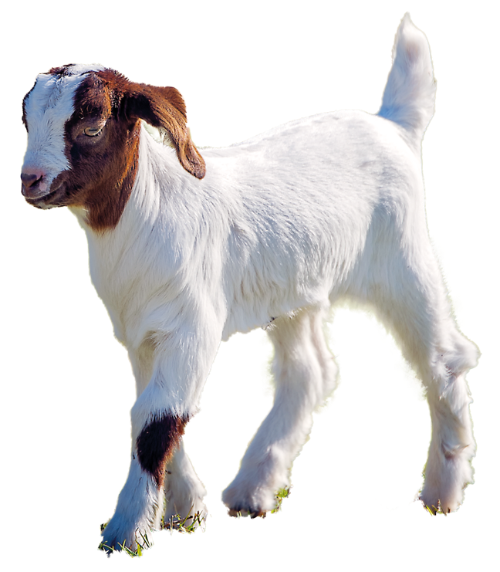
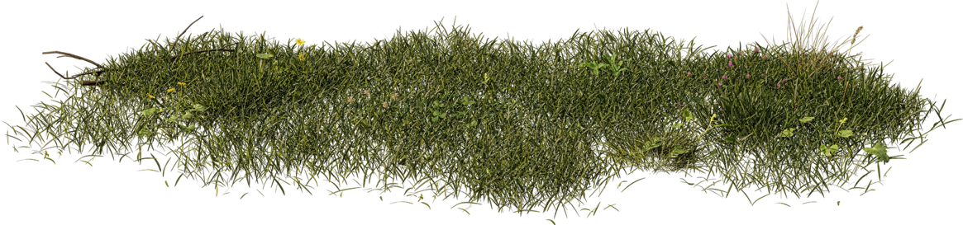
Question
7
Lesson 3
Growing and changing on the farm
As a goat grows and changes, it is called different things.
What is the name
of a baby goat?

Slide 15
Answer
7
Lesson 3
Growing and changing on the farm
Kid

Slide 16
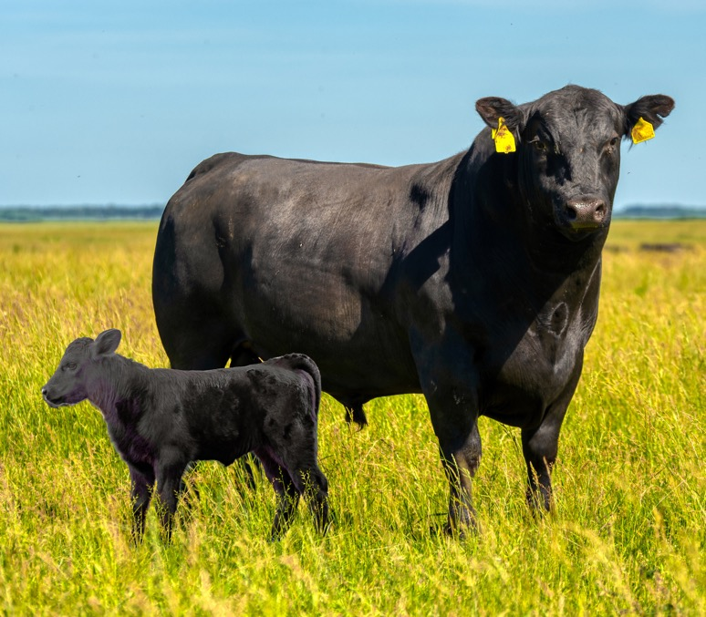
Question
8
Lesson 3
Growing and changing on the farm
A newborn Angus male calf is approximately 70 centimetres tall.
How tall is it when it is an adult Angus bull?
102 centimetres
205 centimetres
187 centimetres

Slide 17
Answer
8
Lesson 3
Growing and changing on the farm
187 centimetres

Slide 18
Question
9
Lesson 3
Growing and changing on the farm
Farmers need to know how to care for their animals so they are healthy and productive.
What is one reason why farmers need to know how old their animals are?

Slide 19
Answer
9
Lesson 3
Growing and changing on the farm
Any of the following:
To give the right medicines
To know how much
food they need
To know when they can be sold
To know when they can produce their own offspring

Slide 20
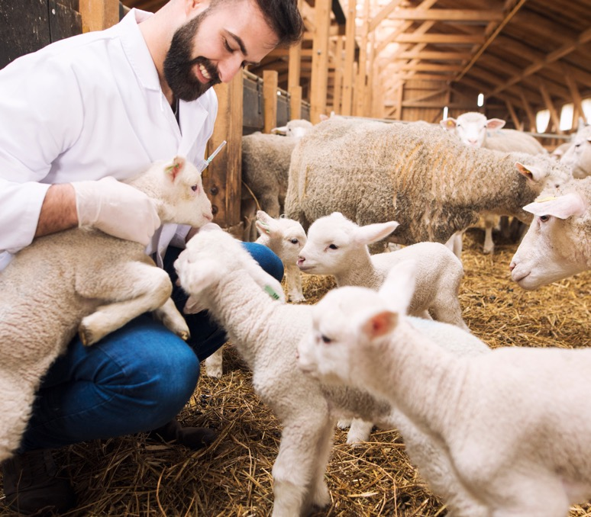
Question
10
Lesson 4
People on the farm
A veterinarian treats sick or injured animals and uses a tool called a stethoscope.
What is a stethoscope used for?
To take the animal’s temperature
To listen to the animal’s breathing and heartbeat
To give the animal a vaccination

Slide 21
Answer
10
Lesson 4
People on the farm
To listen to the animal’s breathing and heartbeat.

Slide 22
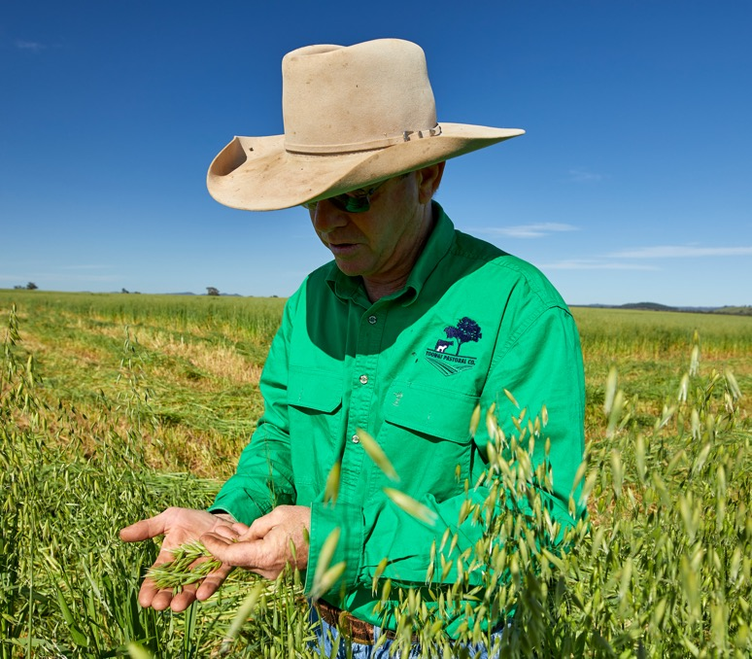
Question
11
Lesson 4
People on the farm
An agronomist is an important person who helps sheep, cattle and goat farmers.
What does an agronomist do?
Helps look after the soil and plants on the farm
Treats sick or injured animals
Transports animals for sale

Slide 23
Answer
11
Lesson 4
People on the farm
Helps look after the soil and plants on a farm

Slide 24
Question
12
Lesson 4
People on the farm
Many people on farms work with animals. Farmers keep their sheep, cattle or goats safe, healthy and content in many ways.
What is one way that a farmer can keep their animals safe, healthy and content?

Slide 25
Answer
12
Lesson 4
People on the farm
Possible answers:
Trimming the hooves of the animals so that they can move around more easily.
Keeping animals in a flock or a herd (group) to help them to feel safe and comfortable.
Making sure animals have access to enough food and water.
Drenching (giving medicine) to animals to protect them from getting sick.

Slide 26
Question
13
Lesson 5
Past, present and future on the farm
Farmers manage the plants and animals on their farms throughout the year to produce the food and fibre that we need.
Which word means later in time?
Future
Yesterday
Past

Slide 27
Answer
13
Lesson 5
Past, present and future on the farm
Future

Slide 28
Question
14
Lesson 5
Past, present and future on the farm
Wool from a sheep is cut once a year using a special tool.
What is the name of the tool used to remove wool?
Scissors
Razor
Shears

Slide 29
Answer
14
Lesson 5
Past, present and future on the farm
Shears

Slide 30
Question
15
Lesson 5
Past, present and future on the farm
Technology can make some farm jobs easier, safer and faster.
How does this robot help cattle, sheep and goat farmers?

Slide 31
Answer
15
Lesson 5
Past, present and future on the farm
It helps move animals from one place to another without the farmer having to be close to them.

Slide 32
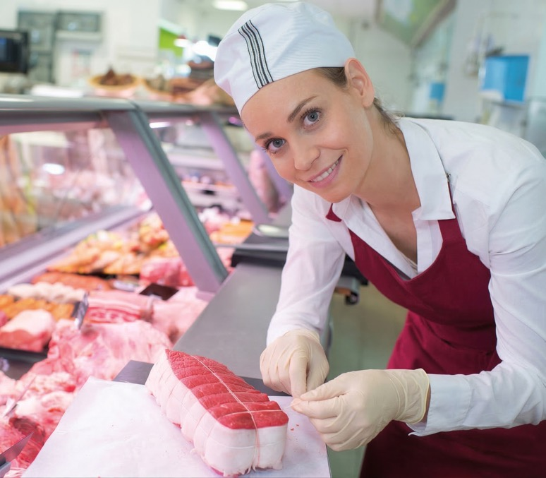
Question
16
Lesson 6
Healthy eating at
home and on the go
A healthy, balanced diet includes eating lean red meat 3-4 times a week paired with a variety of foods like vegetables and legumes/beans.
Name a healthy meal that contains red meat.

Slide 33
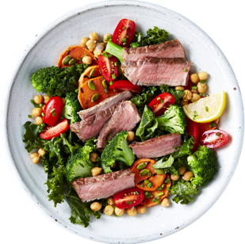
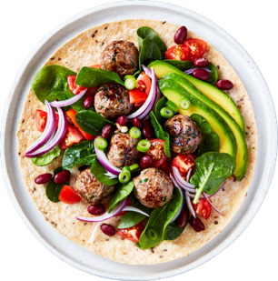
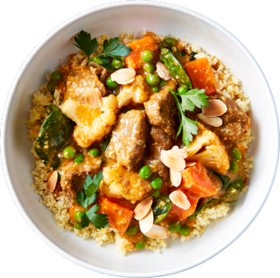
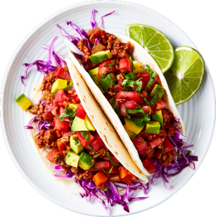
Answer
16
Lesson 6
Healthy eating at
home and on the go
Many possible answers. For example:
Beef and vegetable stir-fry
Lamb roast with vegetables
Thai beef salad
Goat curry with vegetables
and legumes
Tacos
Beef slider with salad

Slide 34
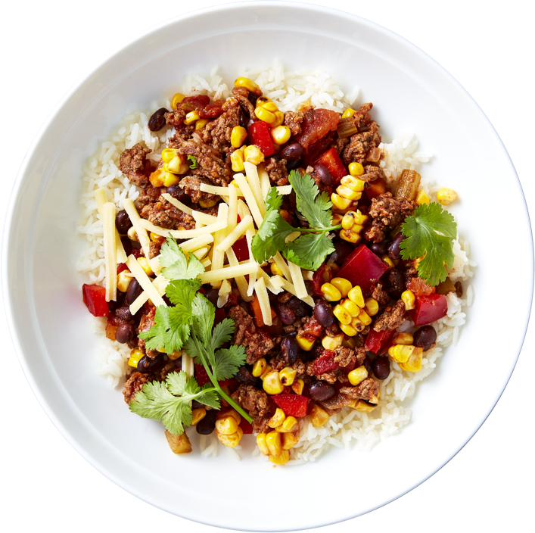
Question
17
Lesson 6
Healthy eating at
home and on the go
Cattle, sheep and goats produce the different types of red meat that we eat.
What type of meat do
cattle produce?

Slide 35
Answer
17
Lesson 6
Healthy eating at
home and on the go
Beef

Slide 36
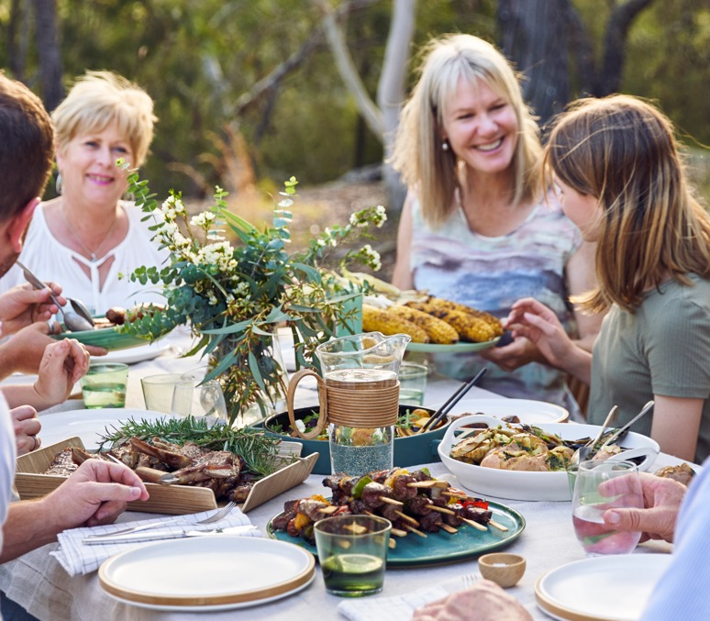
Question
18
Lesson 6
Healthy eating at
home and on the go
To stay healthy, we need to eat food from the five food groups every day.
Name the five food groups.

Slide 37
Answer
18
Lesson 6
Healthy eating at
home and on the go
Vegetables
Fruit
Grains (cereals)
Dairy
Lean meats/alternatives

Slide 38
Scan the QR code to access a range of Australian
Curriculum-aligned F–2 learning resources.
Lessons • Student resources • Classroom posters • Paddock to plate card game • Teaching video
© Meat & Livestock Australia 2026. MLA Australian Good Meat Education has been developed with specialist education services of the Primary Industries Education Foundation Australia. This educational resource is provided under a Creative Commons Licence CC-BY-SA 4.0.

